Slide 1
Improvement in the estimation of troposphere zenith delays using high-accuracy clocks
K. Wang^{1),2)}, M. Rothacher¹⁾, M. Meindl¹⁾, E. Schoenemann³⁾, W. Enderle³⁾
Institute of Geodesy and Photogrammetry, ETH Zurich, Switzerland
GNSS Research Centre, Curtin University, Australia
ESA/ESOC, Navigation Support Office, Darmstadt, Germany

Slide 2
Overview
Introduction: clock modeling and kinematic height estimation
Motivation for this study
Results without and with clock modeling:
Influence on kinematic heights
Influence on zenith path delays (ZPD)
Comparison with meteo and WVR data (CEBR and ONSA)
Conclusions

Slide 3
Highly accurate clocks (H-masers) Clock quality of some selected IGS stations
Standard deviation $σ$ of clock estimates after removing a linear polynomial over one day
Standard deviation of epoch-to-epoch clock differences $σ_{e}$ after removing a linear polynomial.
Standard deviations $σ$ of the order of 30-120 ps (1 - 4 cm)
The epoch-to-epoch repeatability $σ_{e}$ is on the level of 10 - 20 ps (3 - 6 mm, phase noise)
Indication of the size of the constraints for the clocks
Station | $σ$ (in ps) | $σ_{e}$ (in ps)
CEBR | 86 | 19
HERS | 30 | 13
HRAO | 39 | 11
MGUE | 27 | 10
PTBB | 114 | 12
ZECK | 30 | 11
August 8, 2015

Slide 4
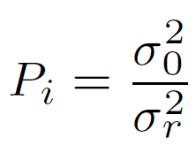
Highly accurate clocks Clock model
Clocks are modelled with offset $a_{0}$, drift $a_{1}$ and a stochastic parameter $p_{i}$
Relative constraints may be imposed on the stochastic parameter
Very weak absolute constraints are imposed for regularization

Slide 5
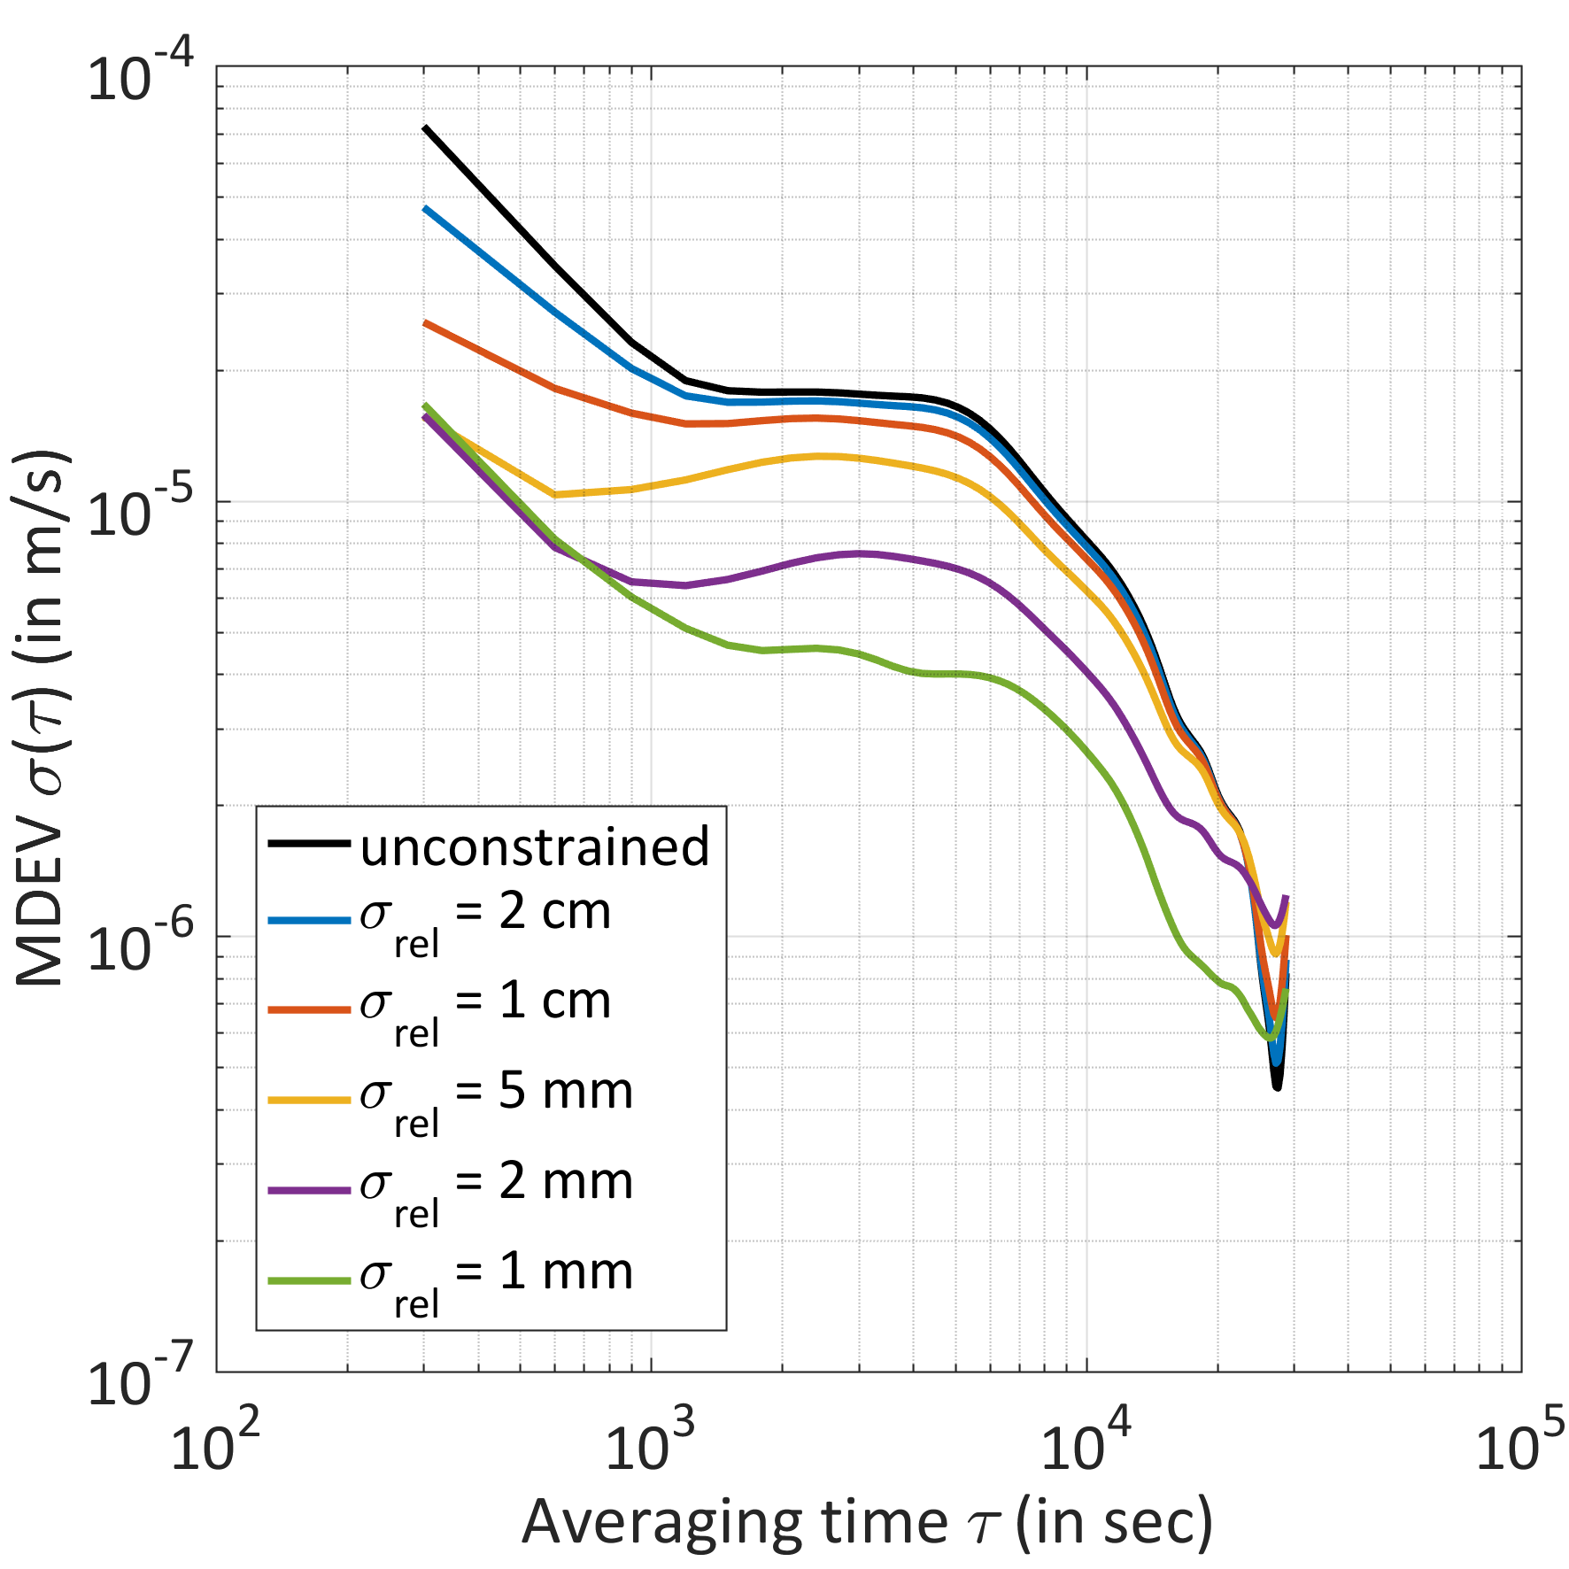
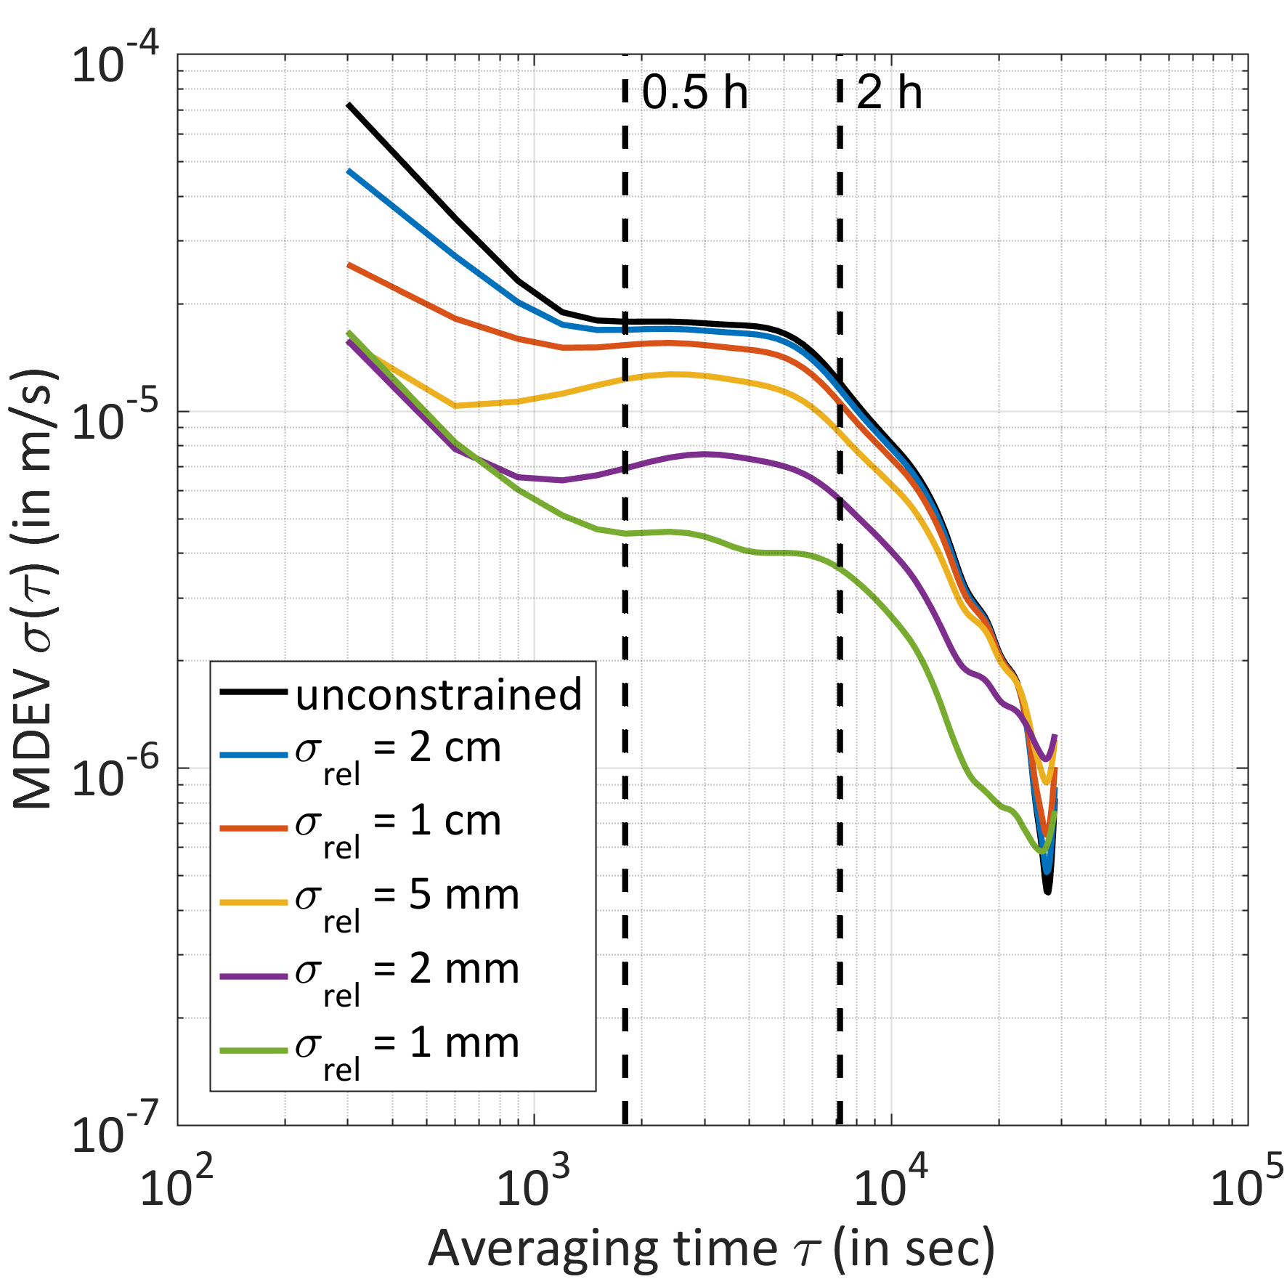
Motivation Kinematic station height with clock model
~ τ⁻¹ : flicker noise
Standard deviation of kinematic heights without ($σ$) and with best clock model ($σ_{c}$)
Station | $σ$ (in cm) | $σ_{c}$ (in cm) | Improvement
CEBR | 8 | 4 | 2.0
HERS | 9 | 4 | 2.3
HRAO | 49 | 14 | 3.5
MGUE | 12 | 5 | 2.4
PTBB | 10 | 4 | 2.5
ZECK | 9 | 3 | 3.0
?
PTBB
ZPD sampling of 2 hours

Slide 6
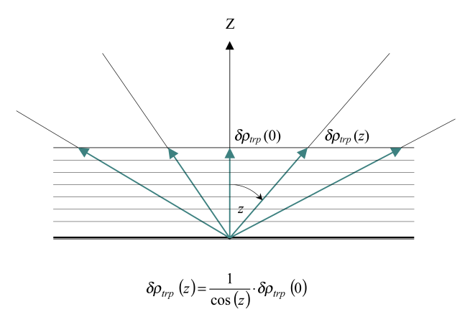
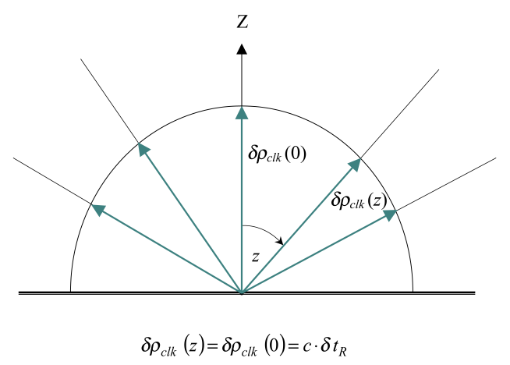
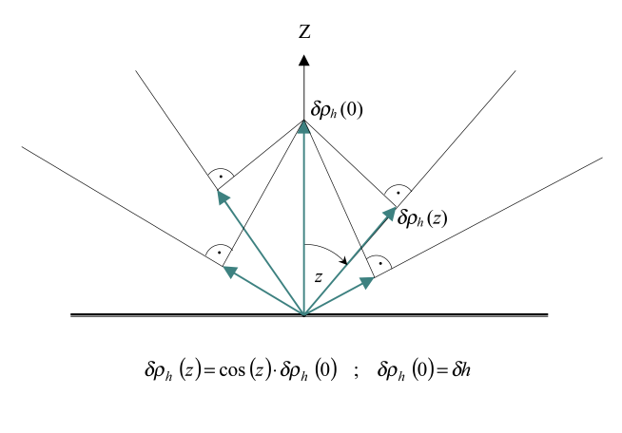
Motivation Correlation of troposphere, station clock, and height
Troposphere
Station clock
Station height

Slide 7
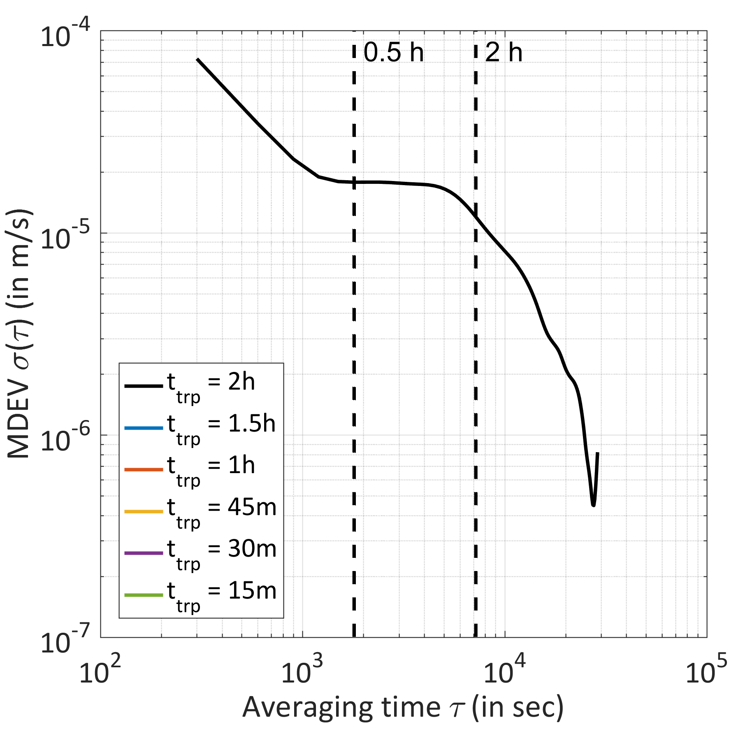
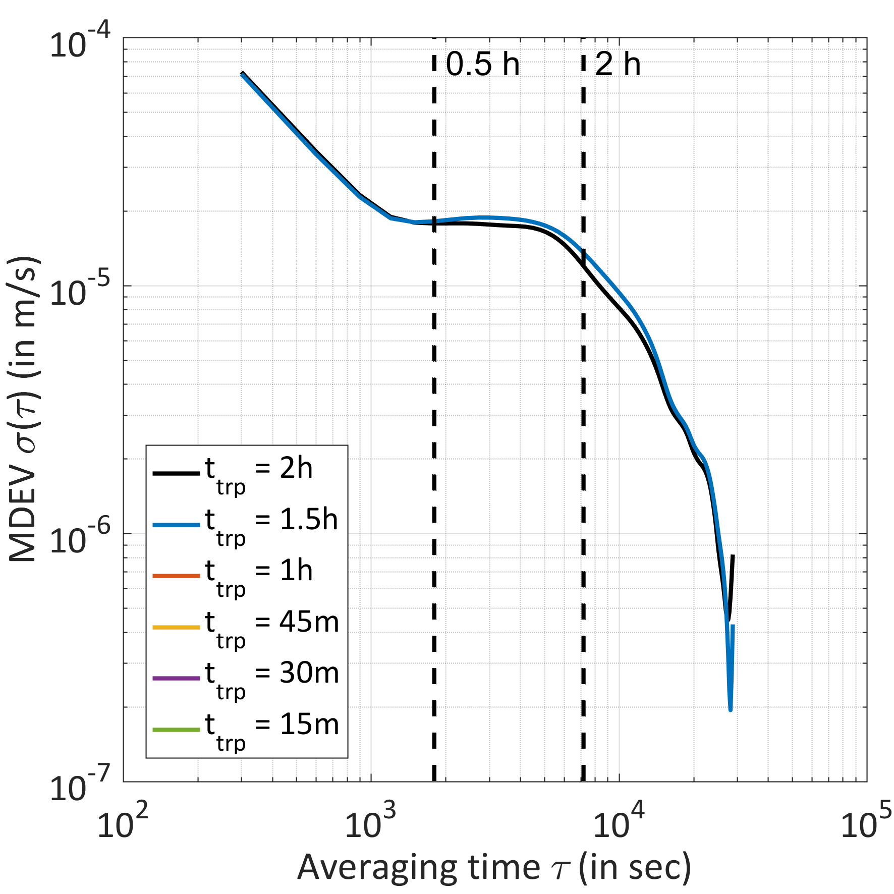
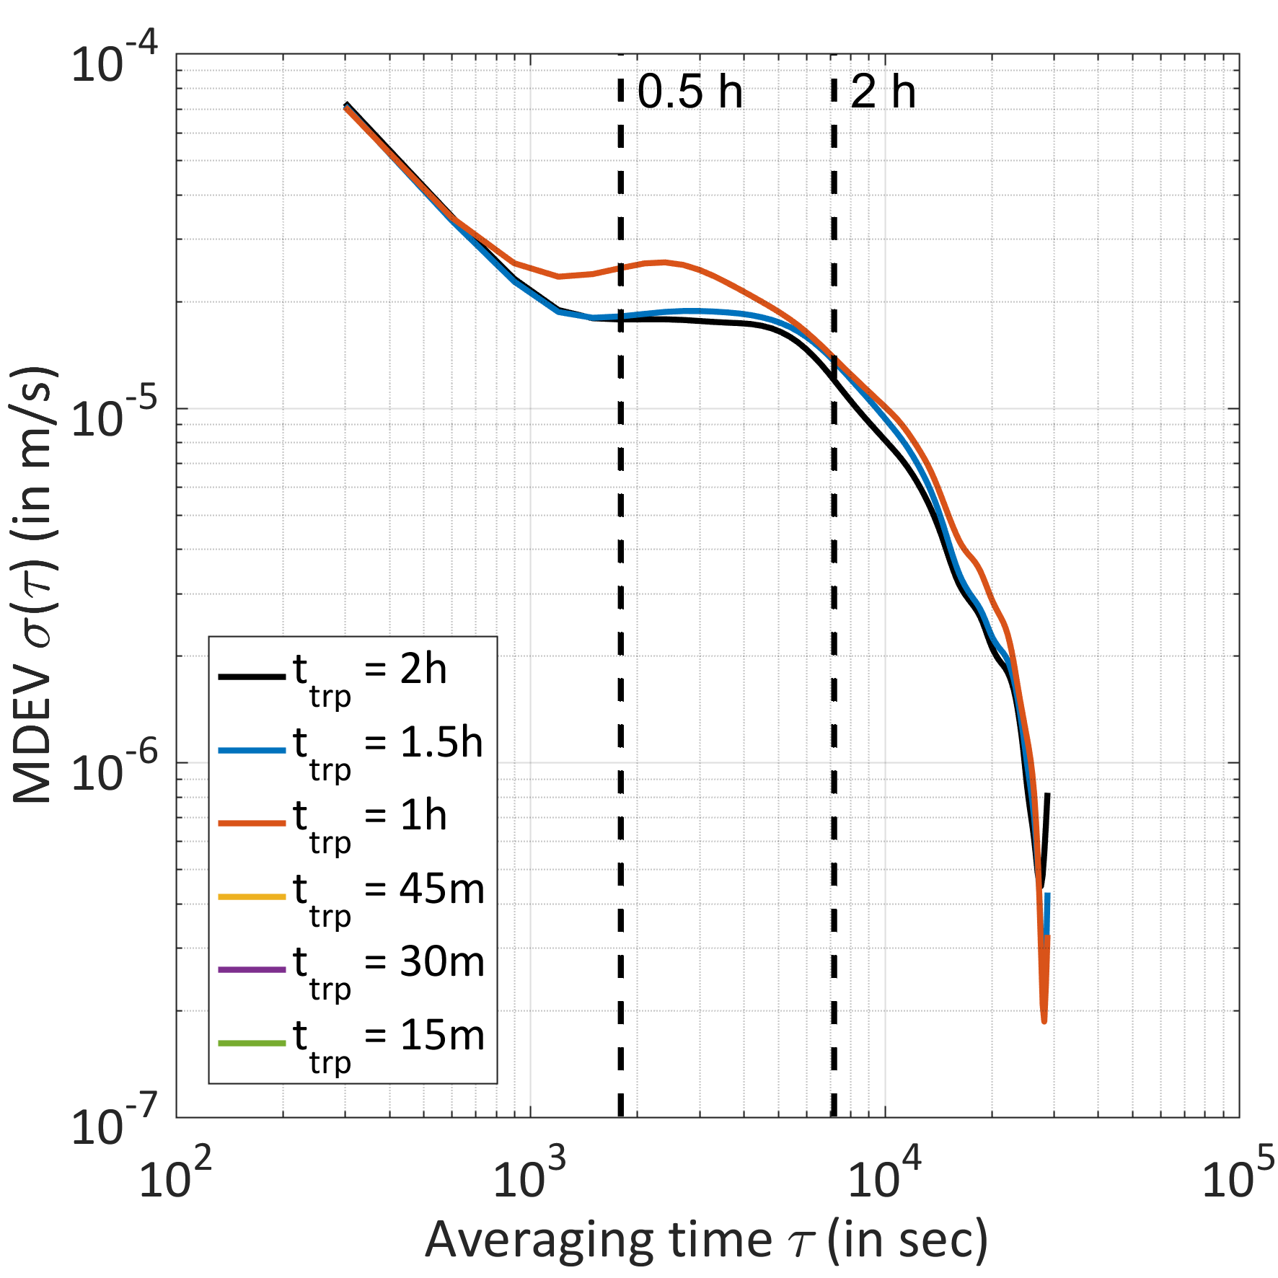
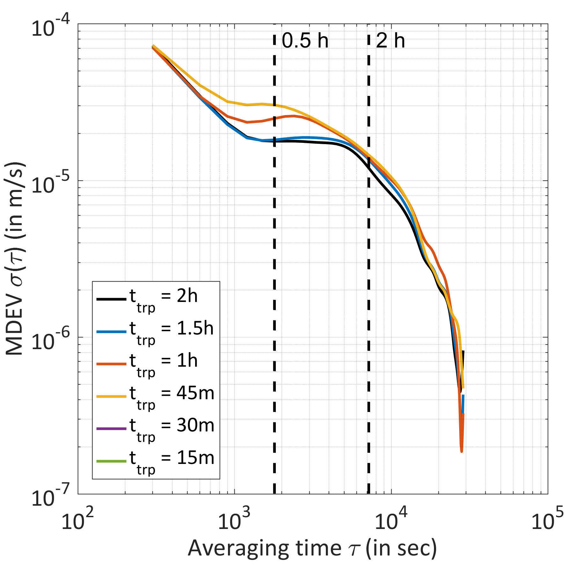
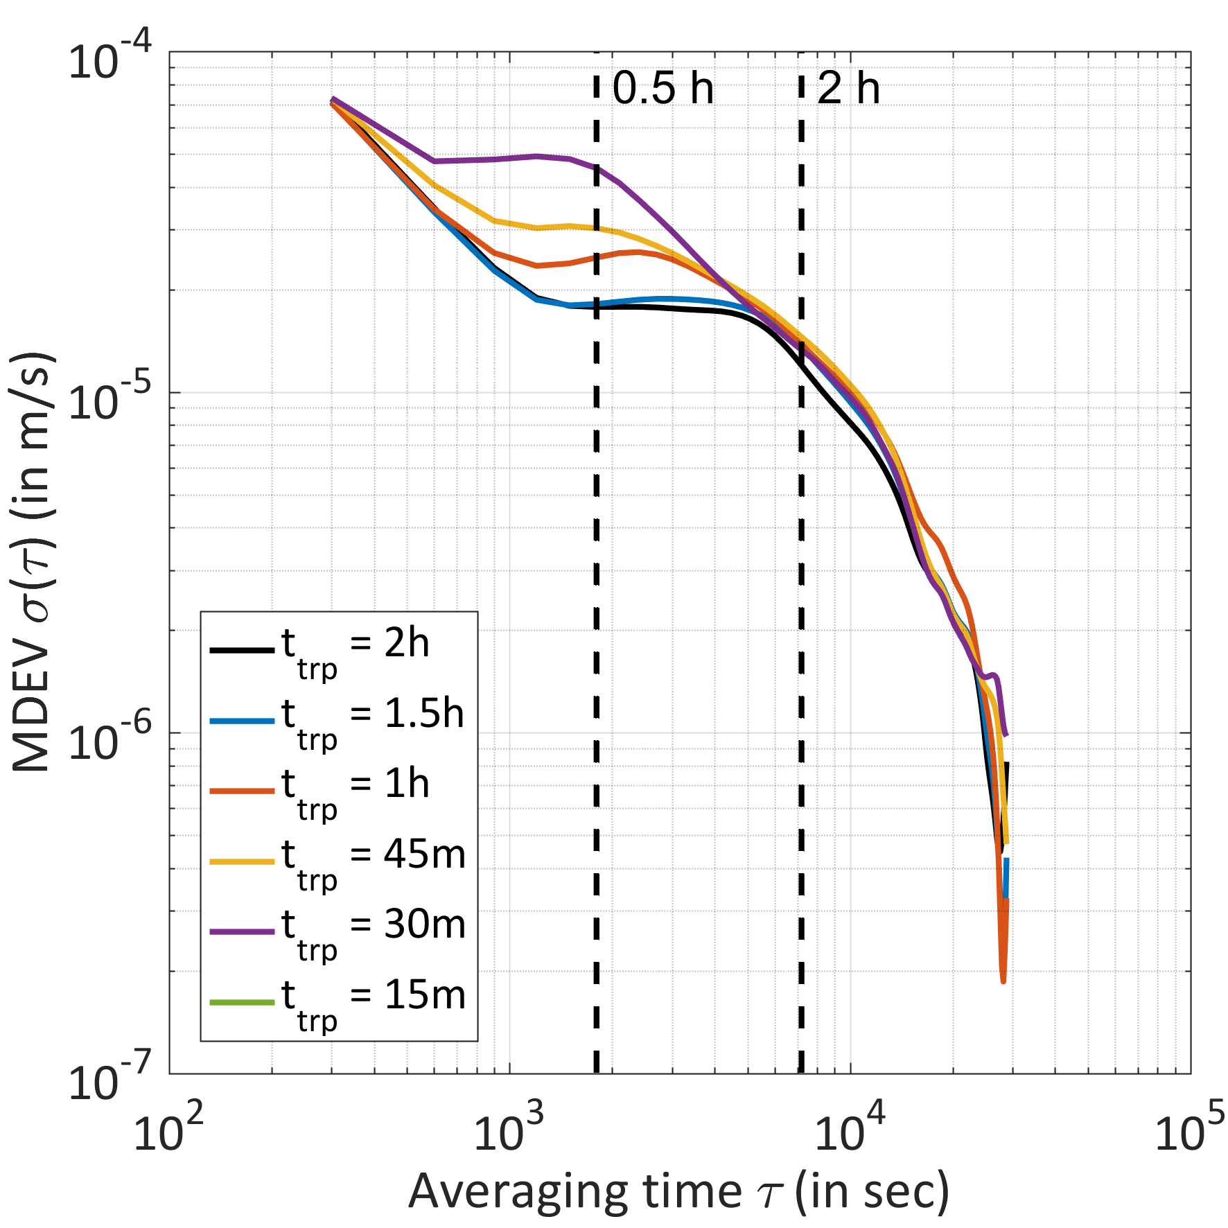
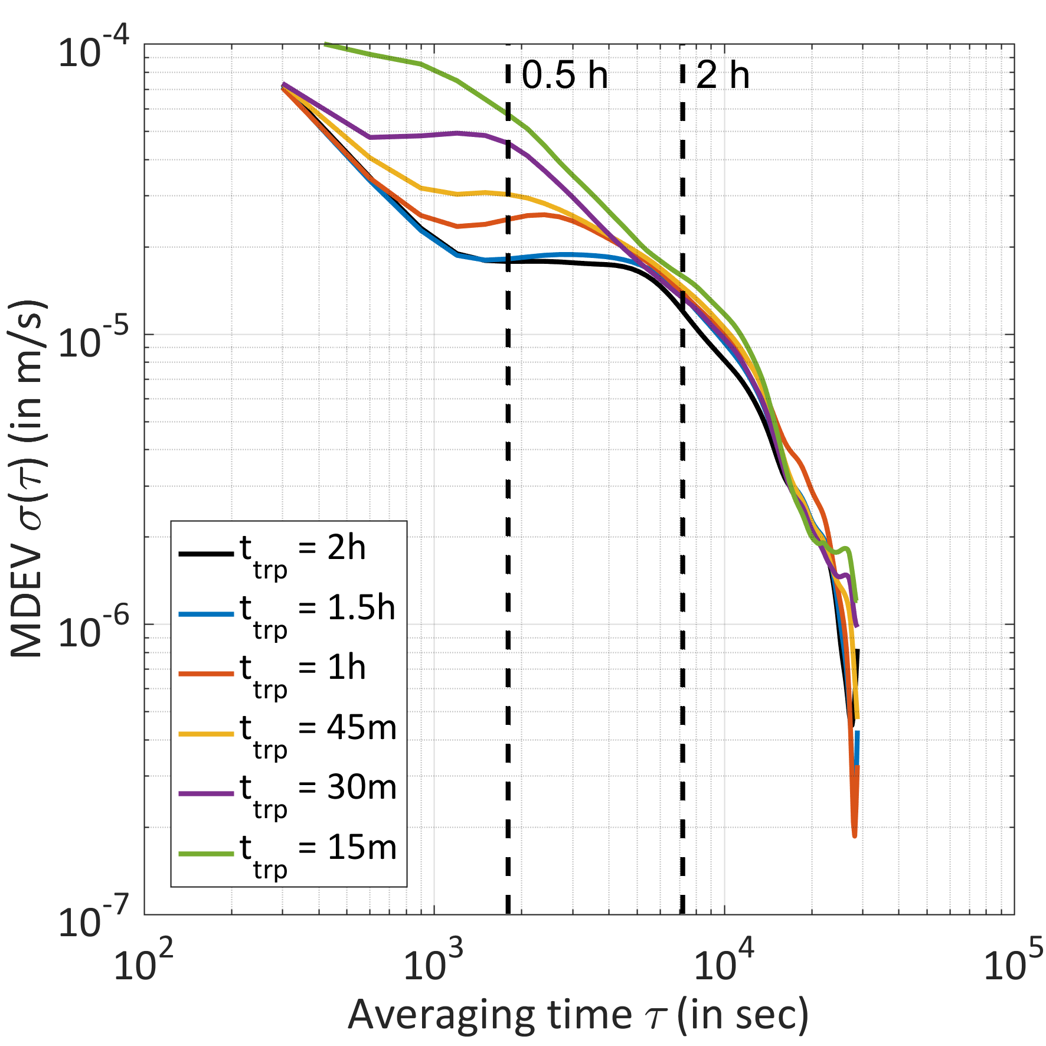
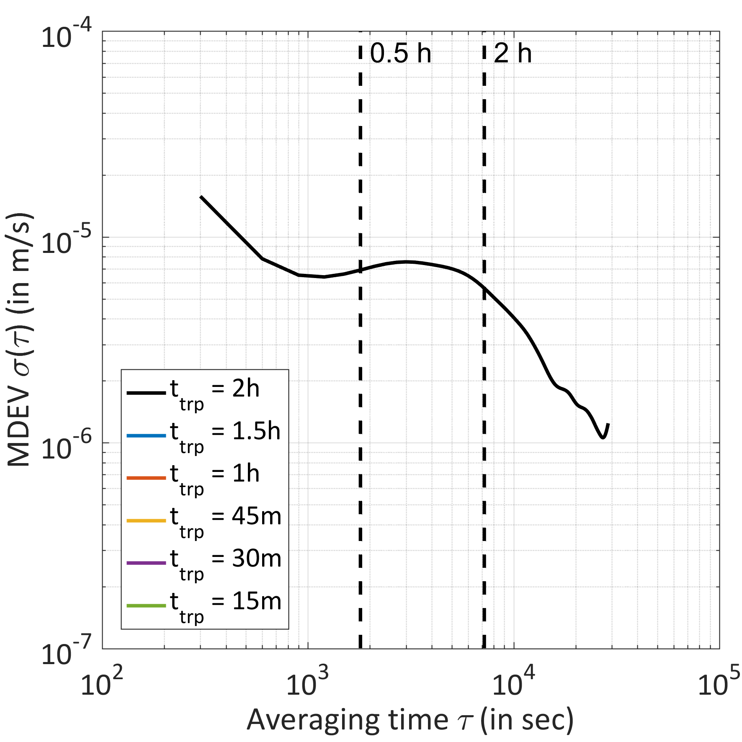
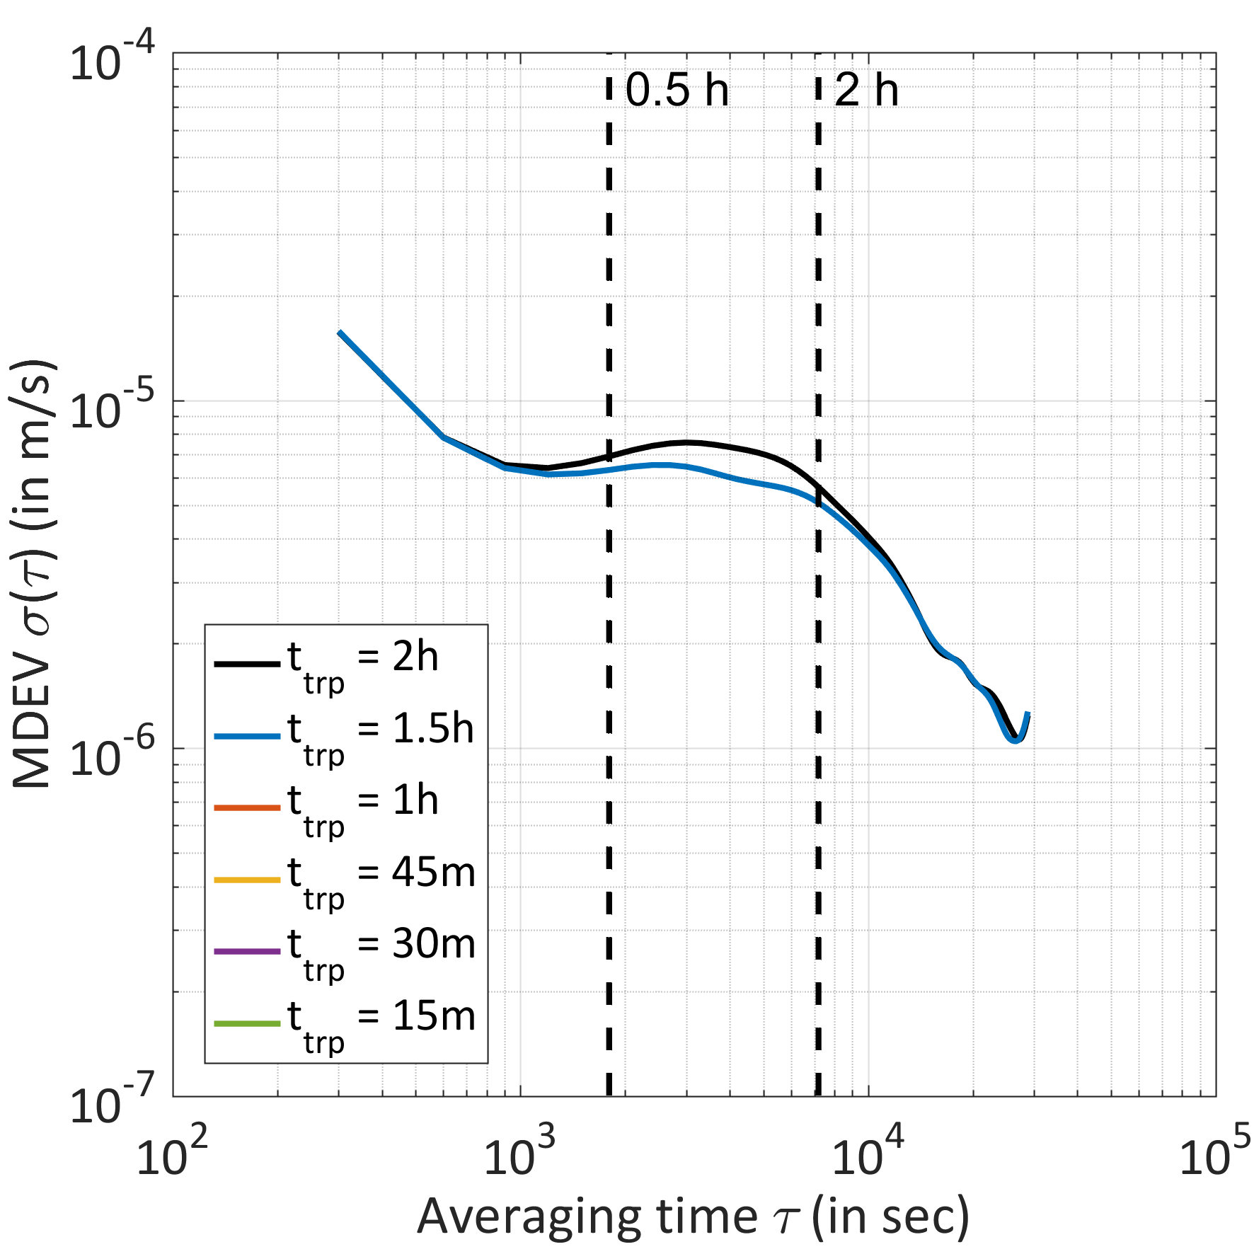
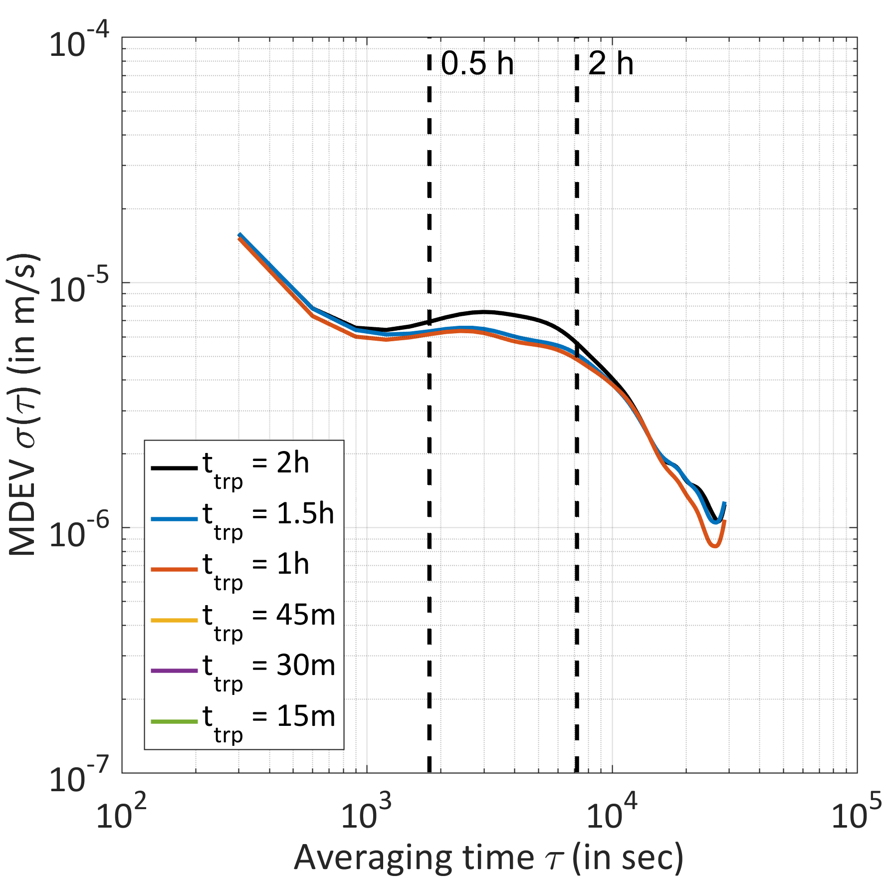
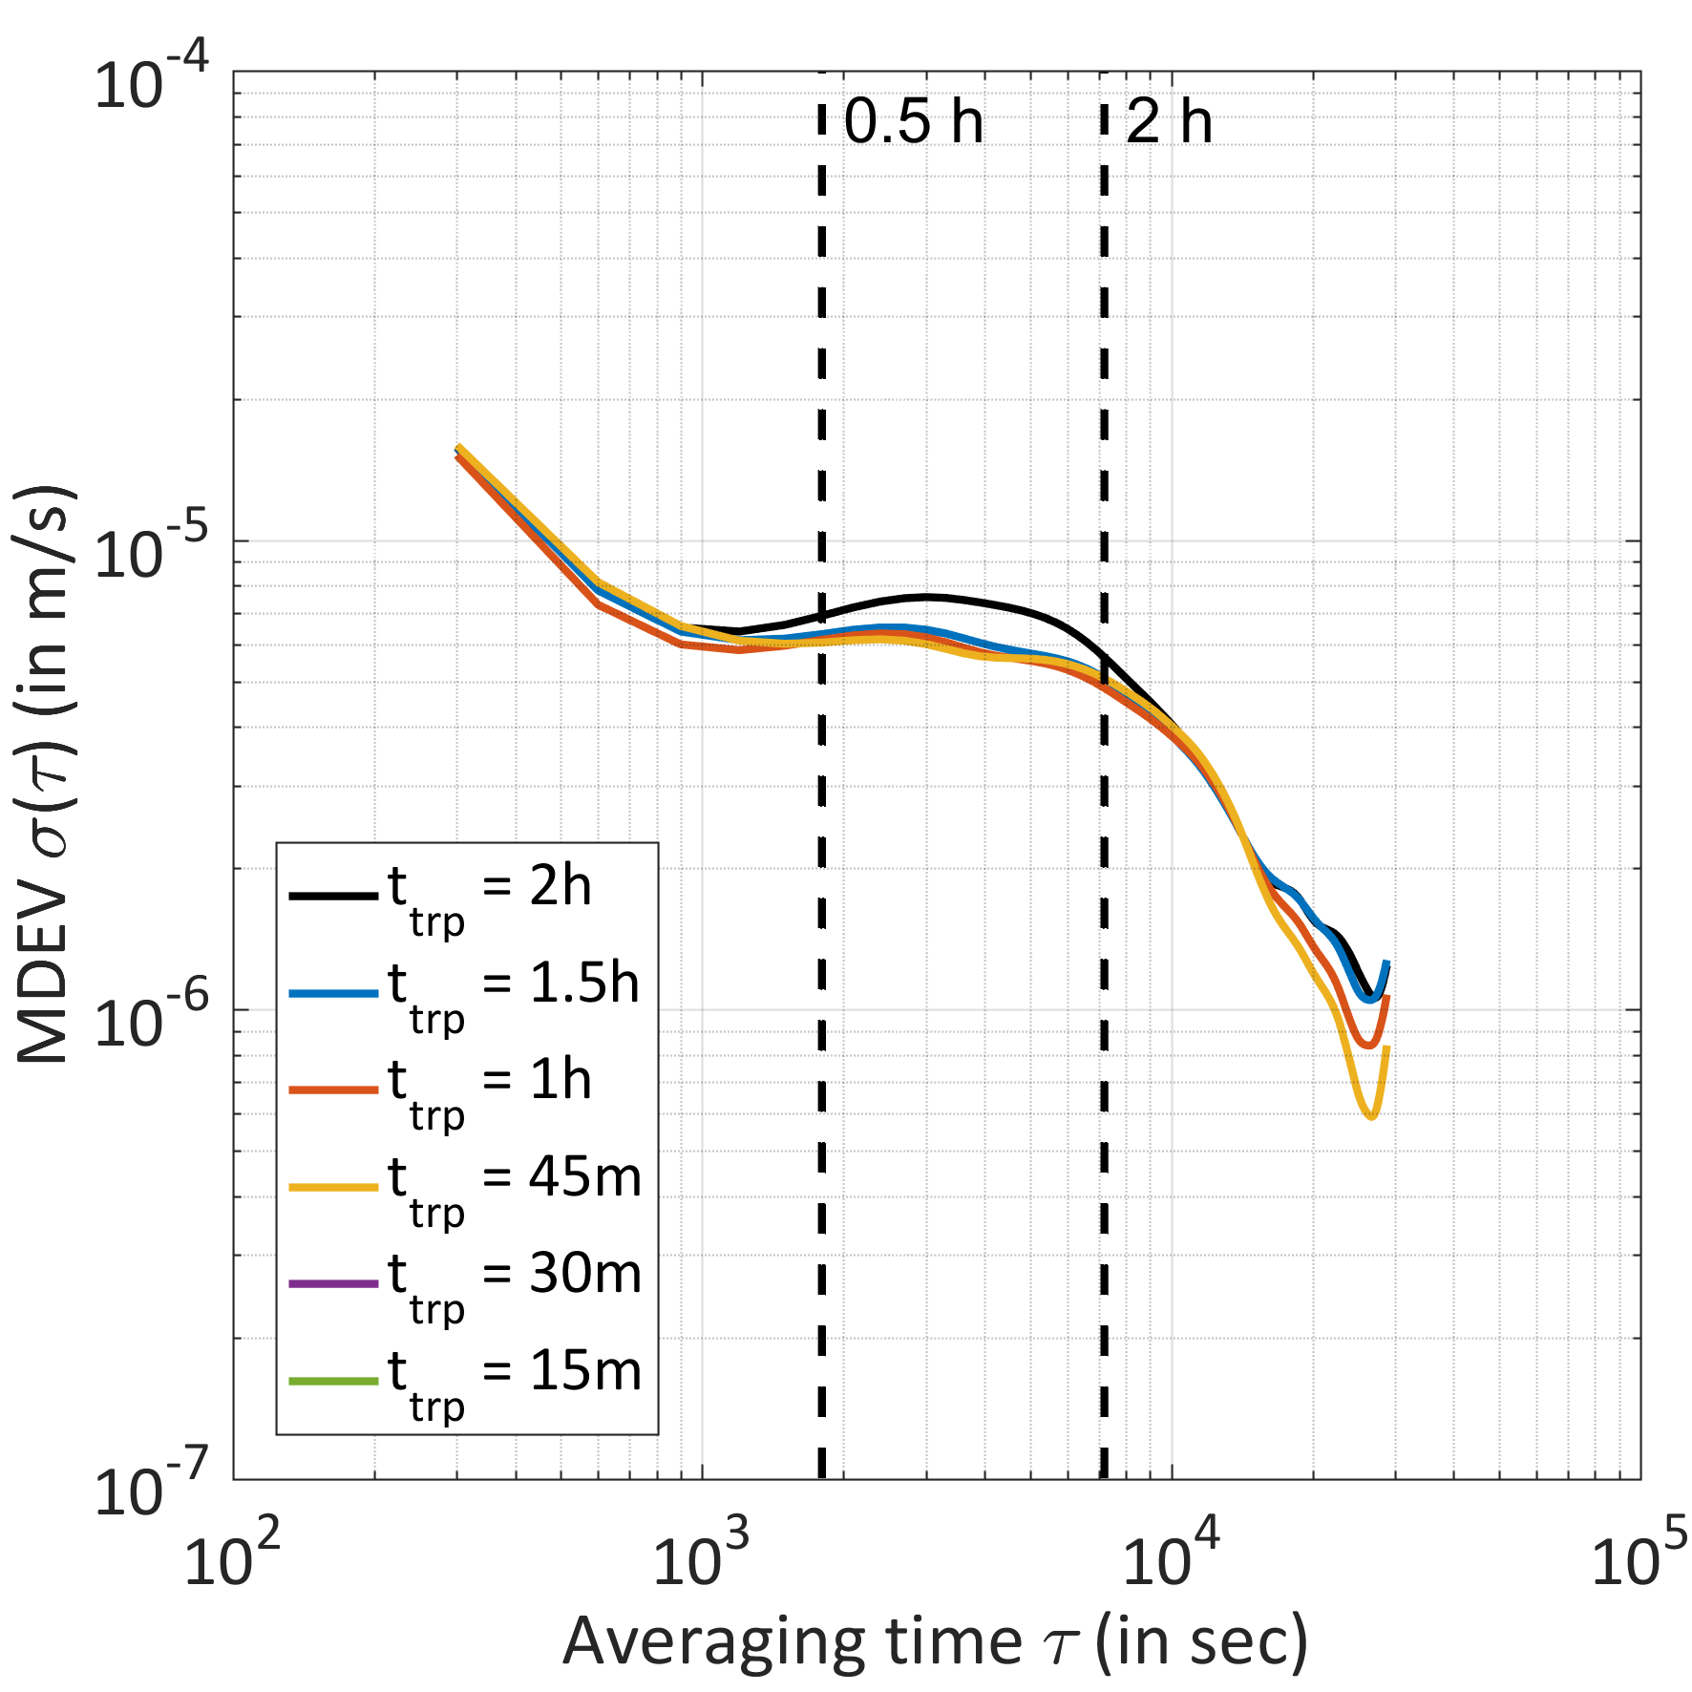
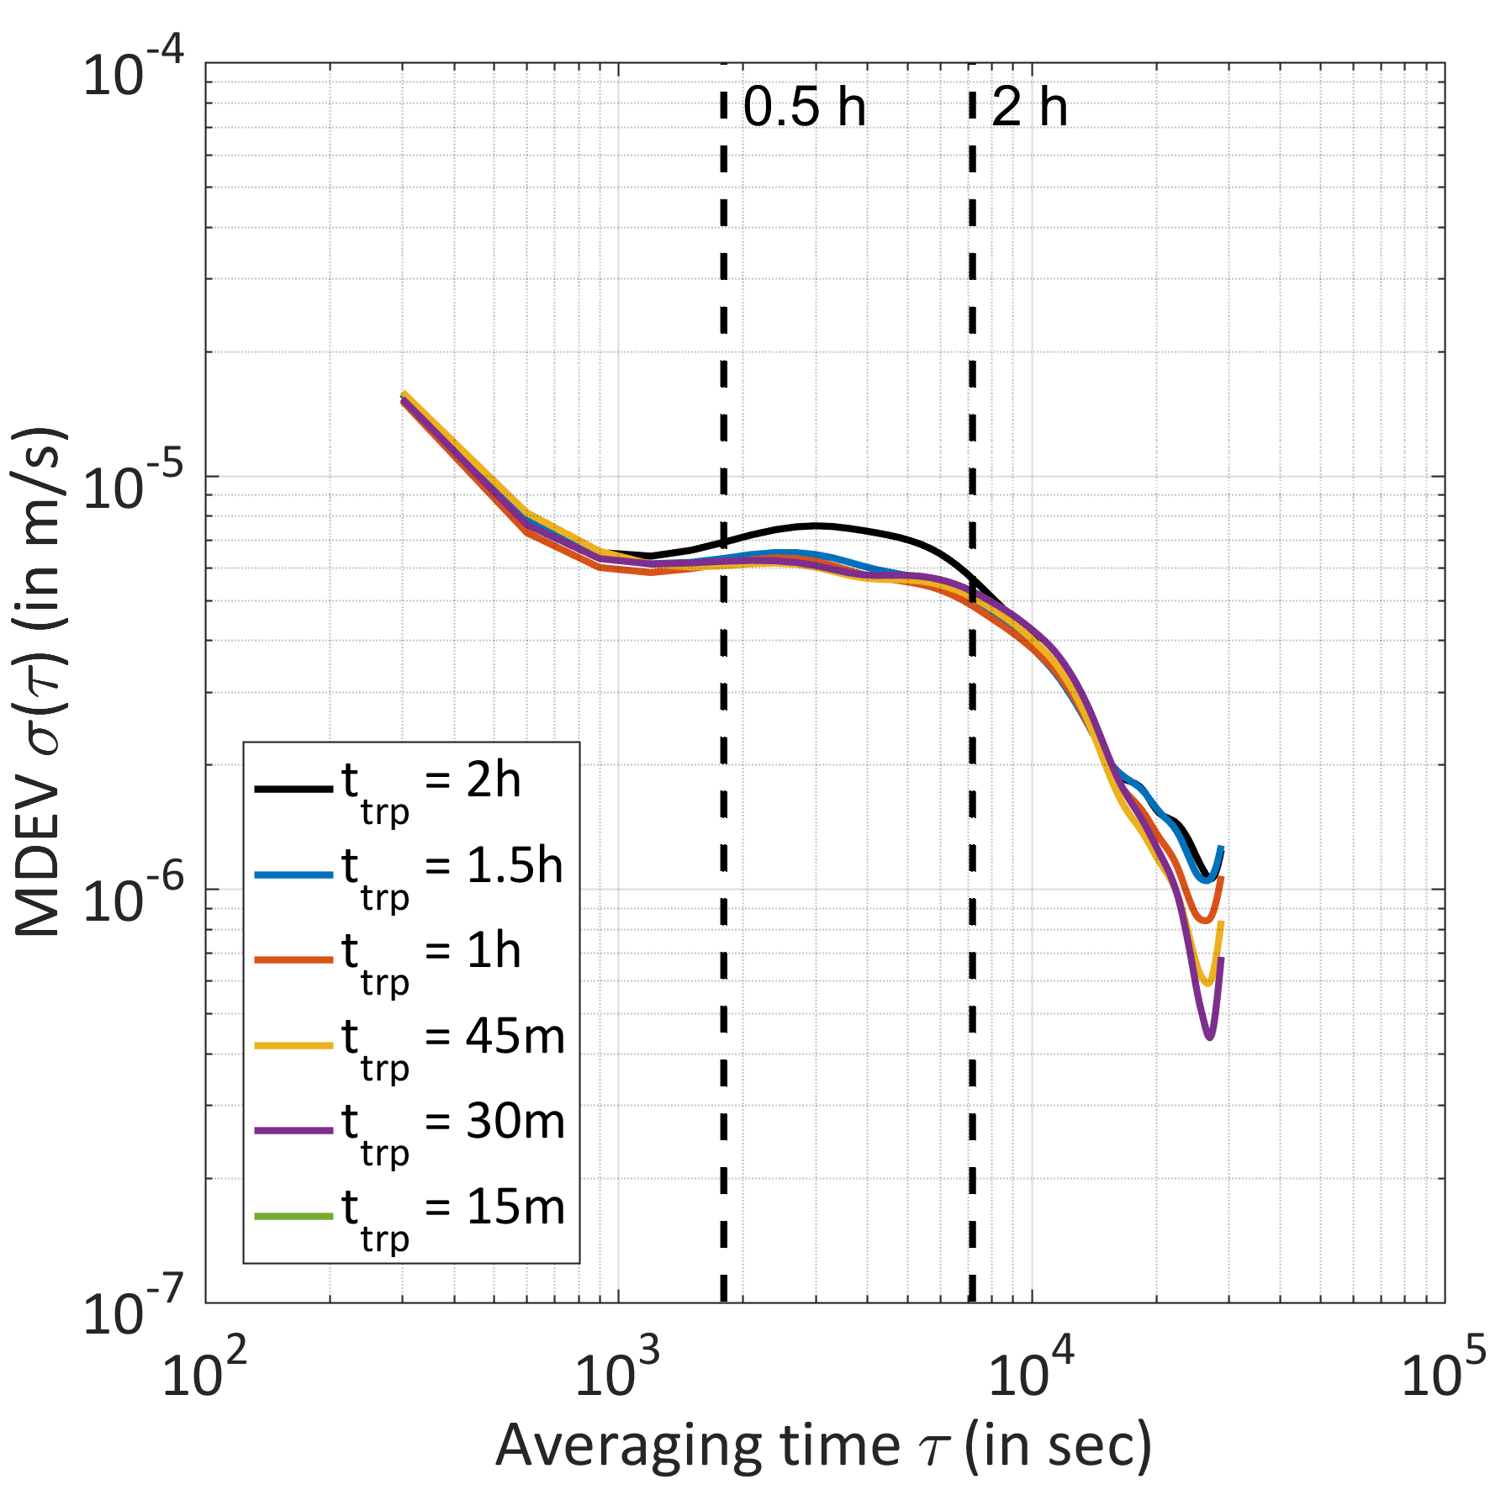
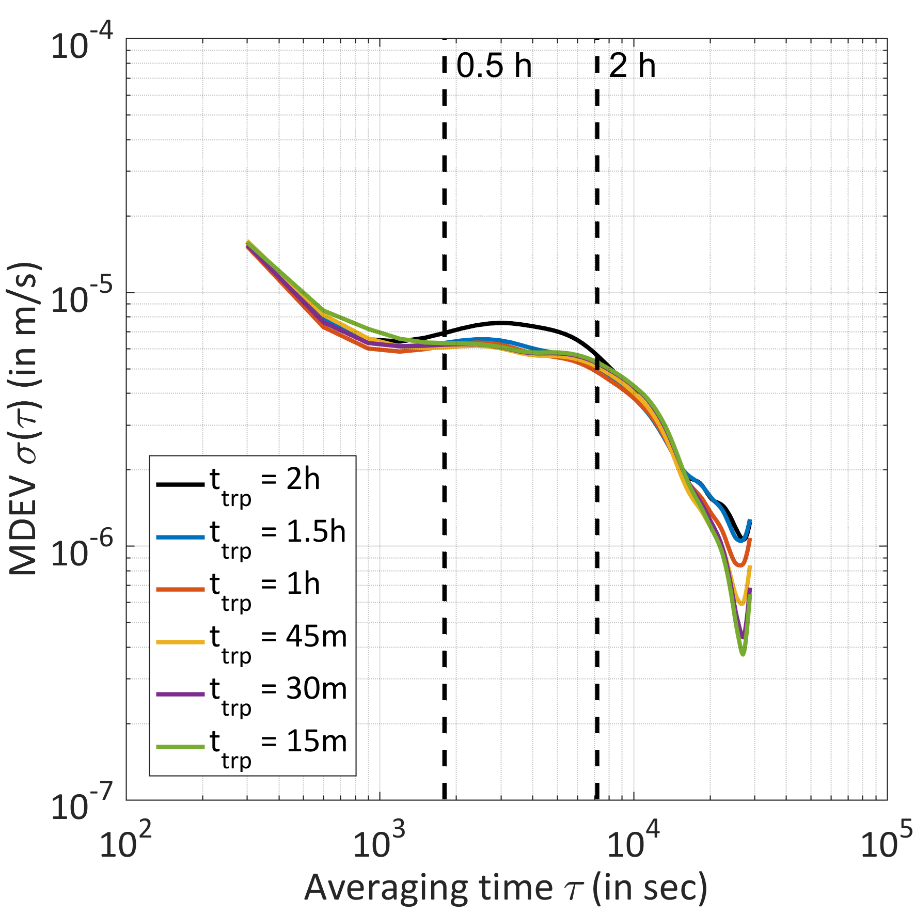
Kinematic station height: varying the ZPD resolution
PTBB
PTBB
No clock model
Clock model with 1 mm constraint

Slide 8
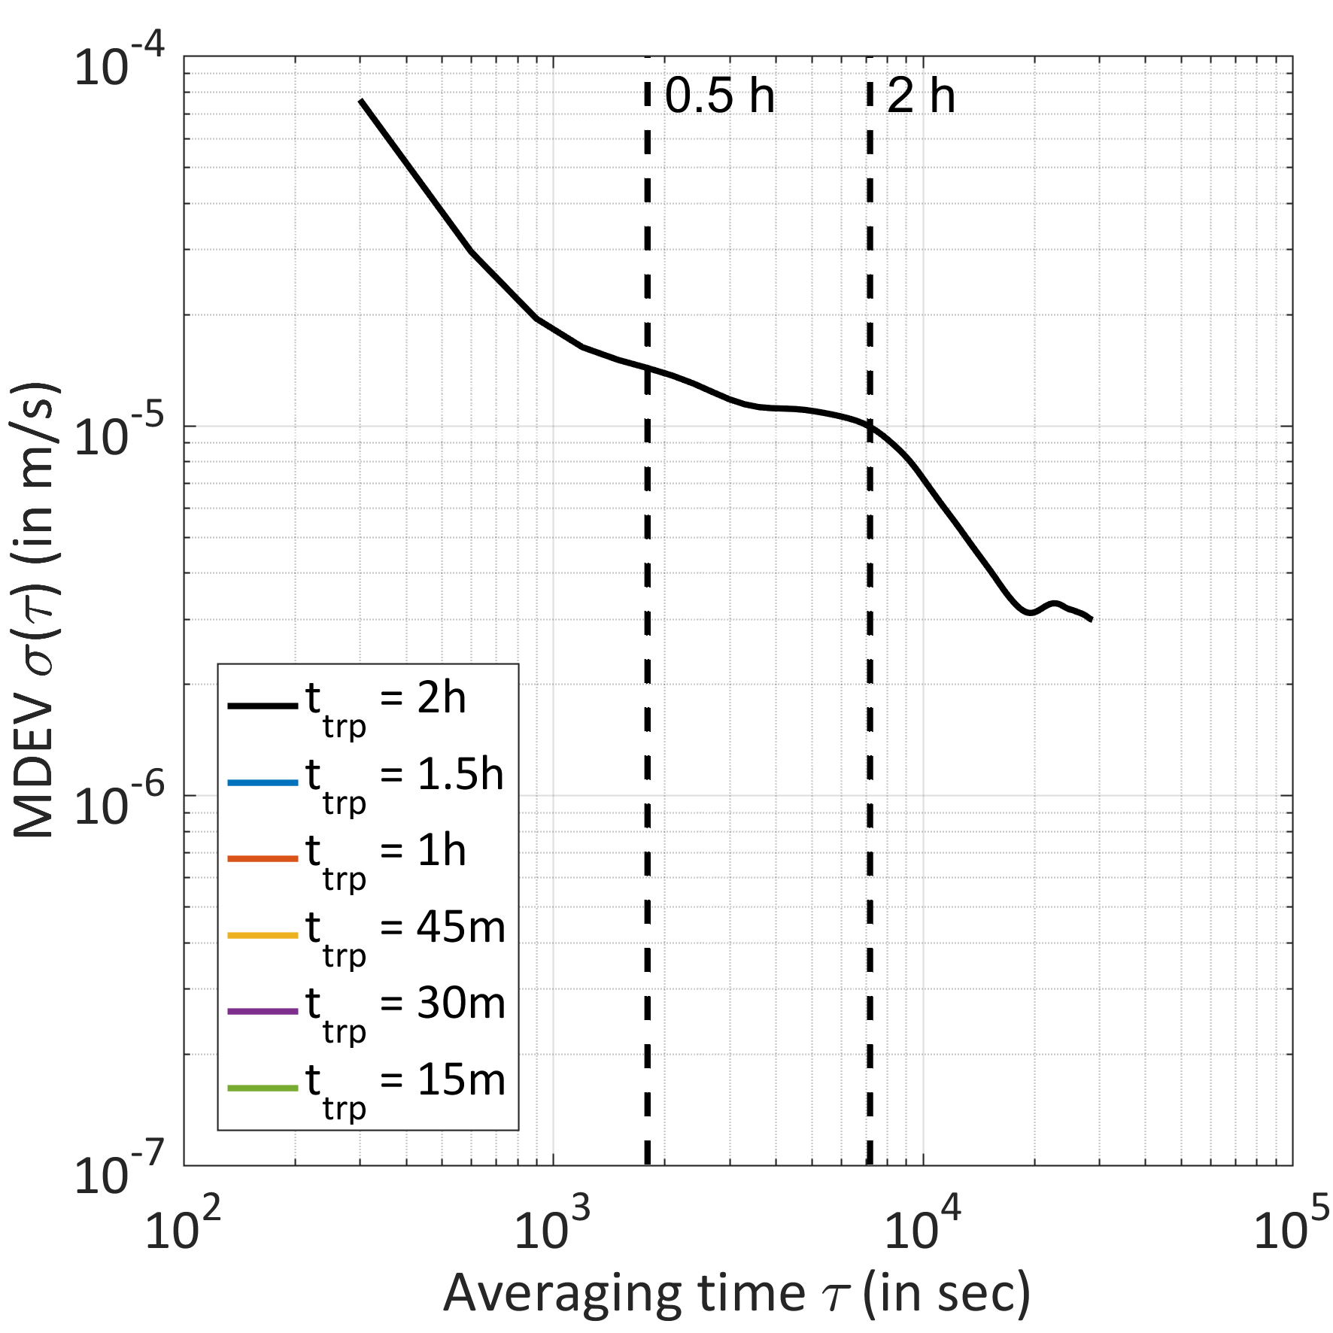
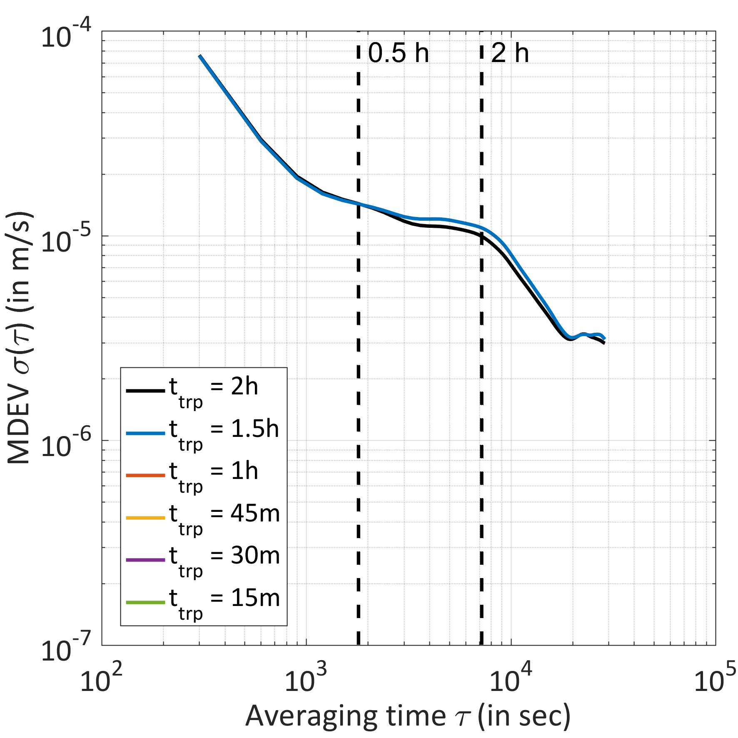
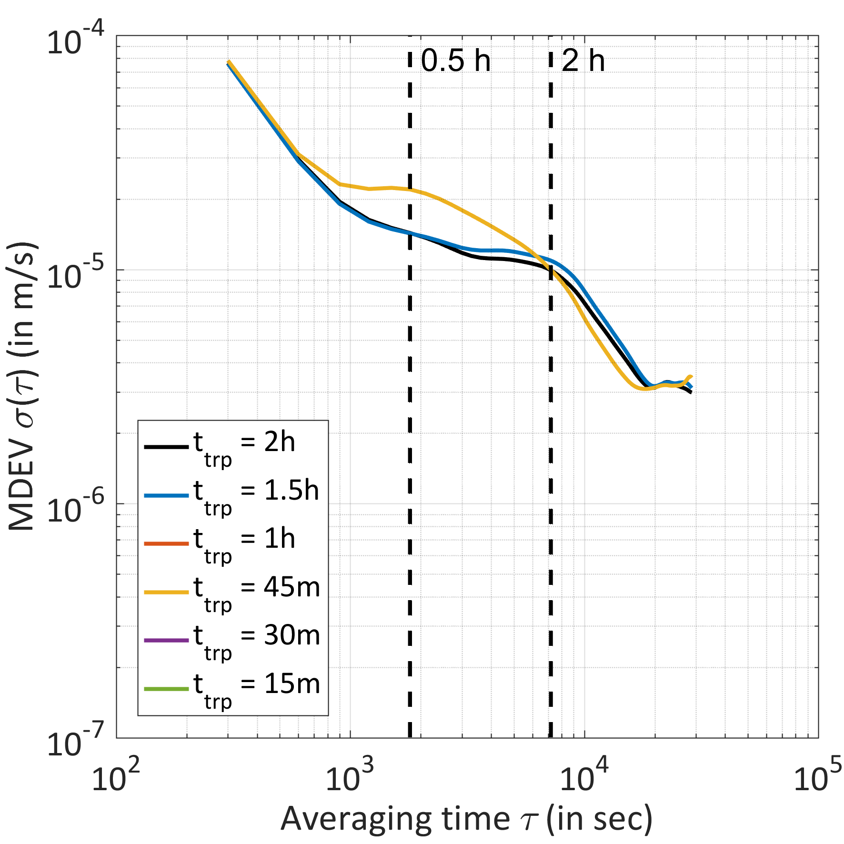
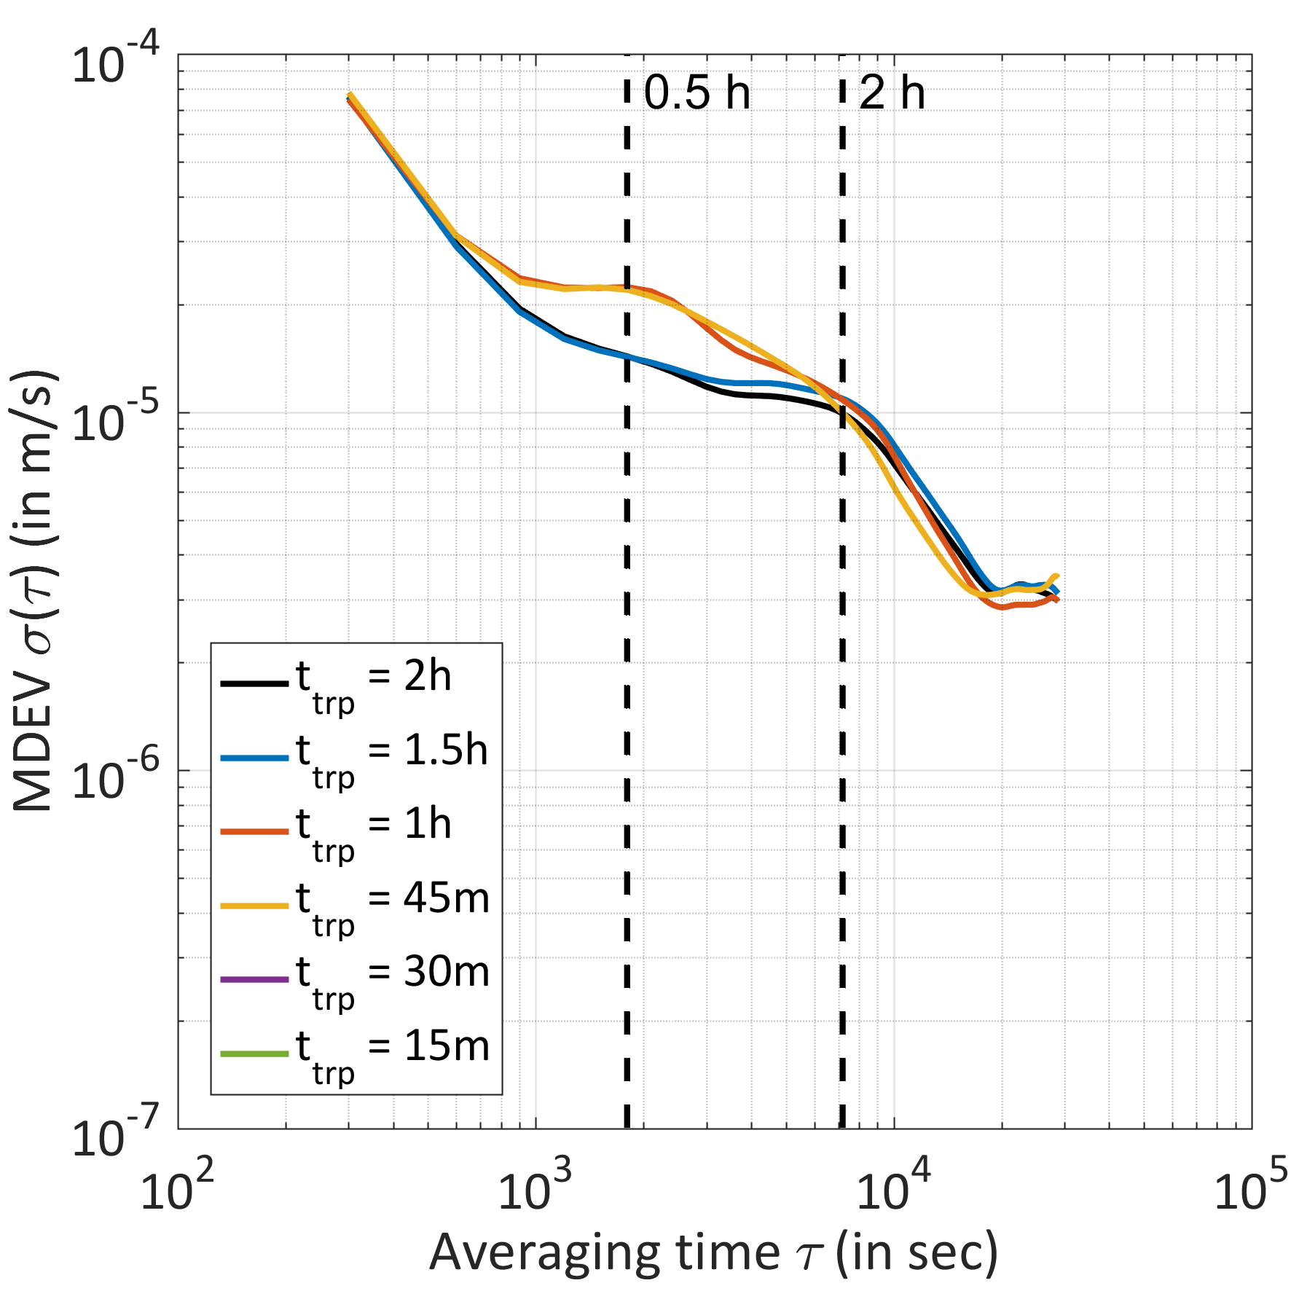
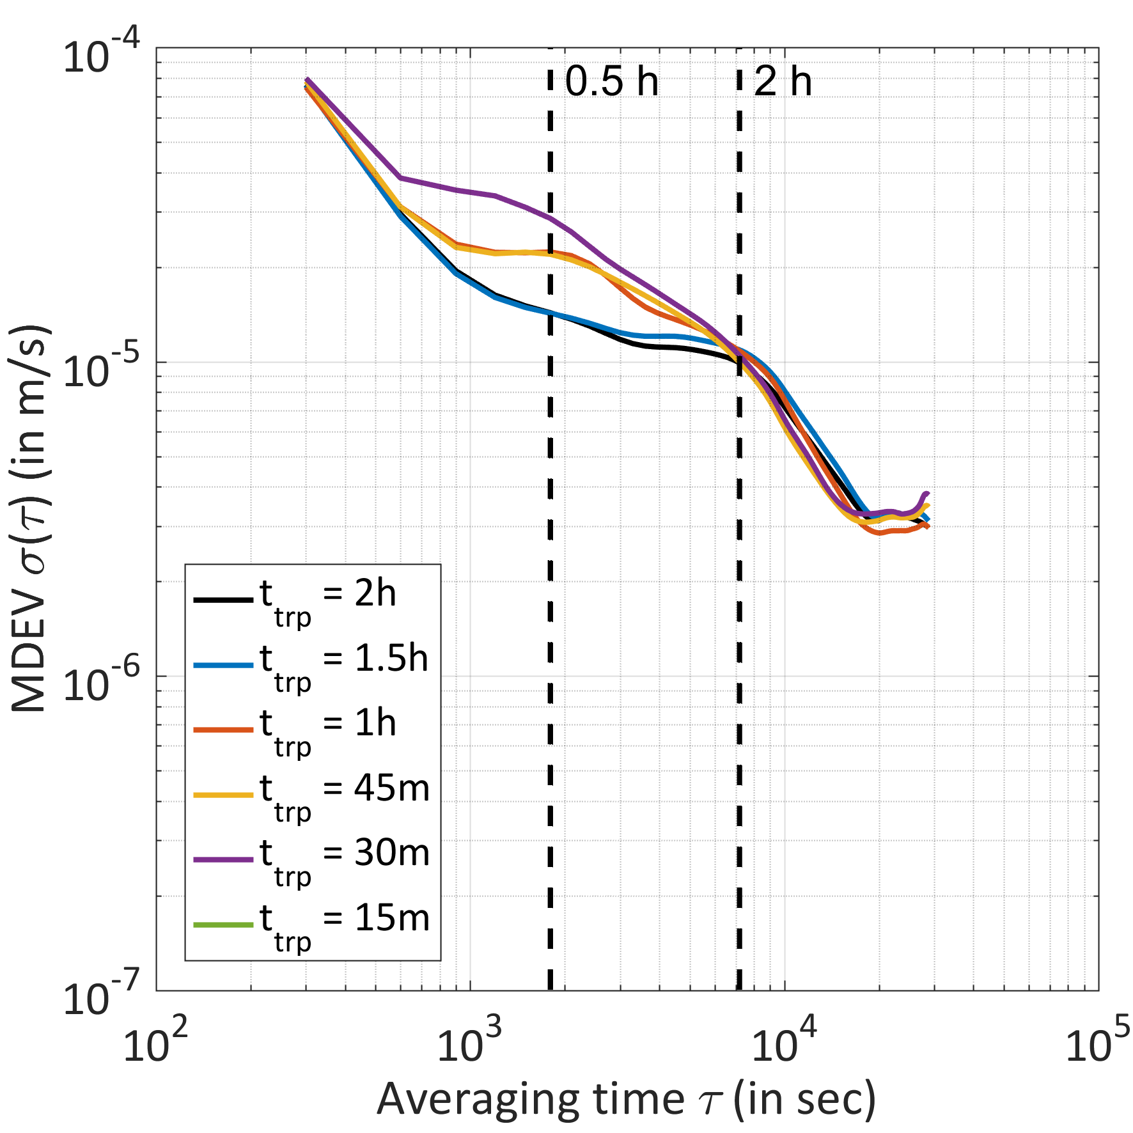
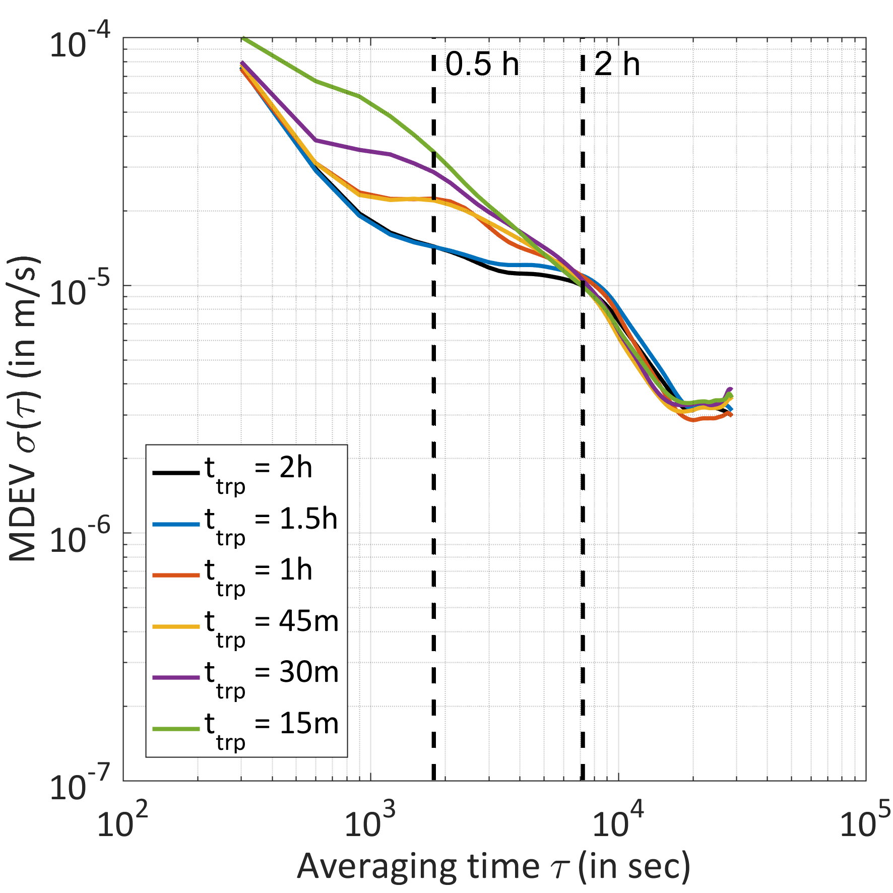
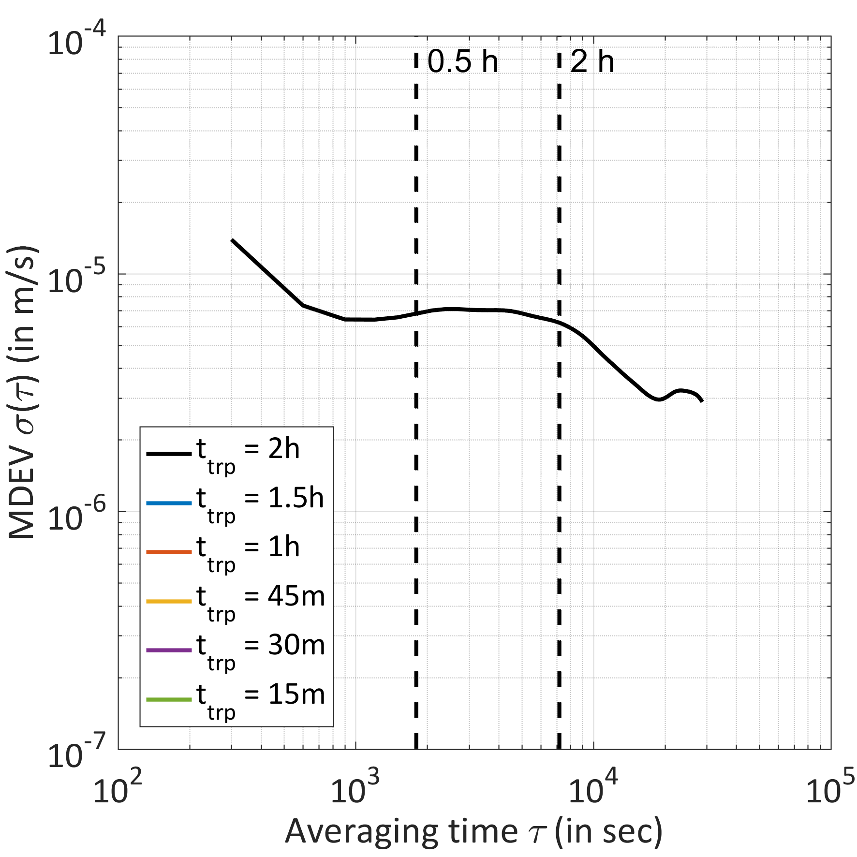
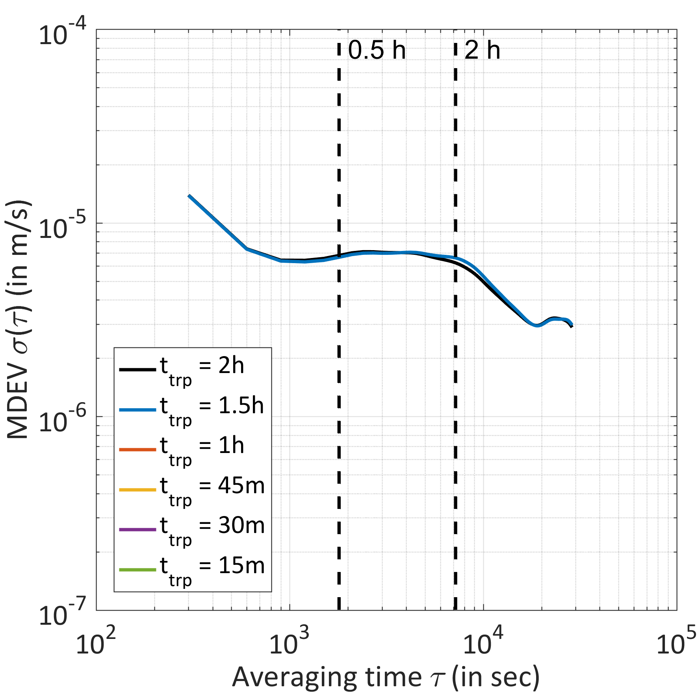
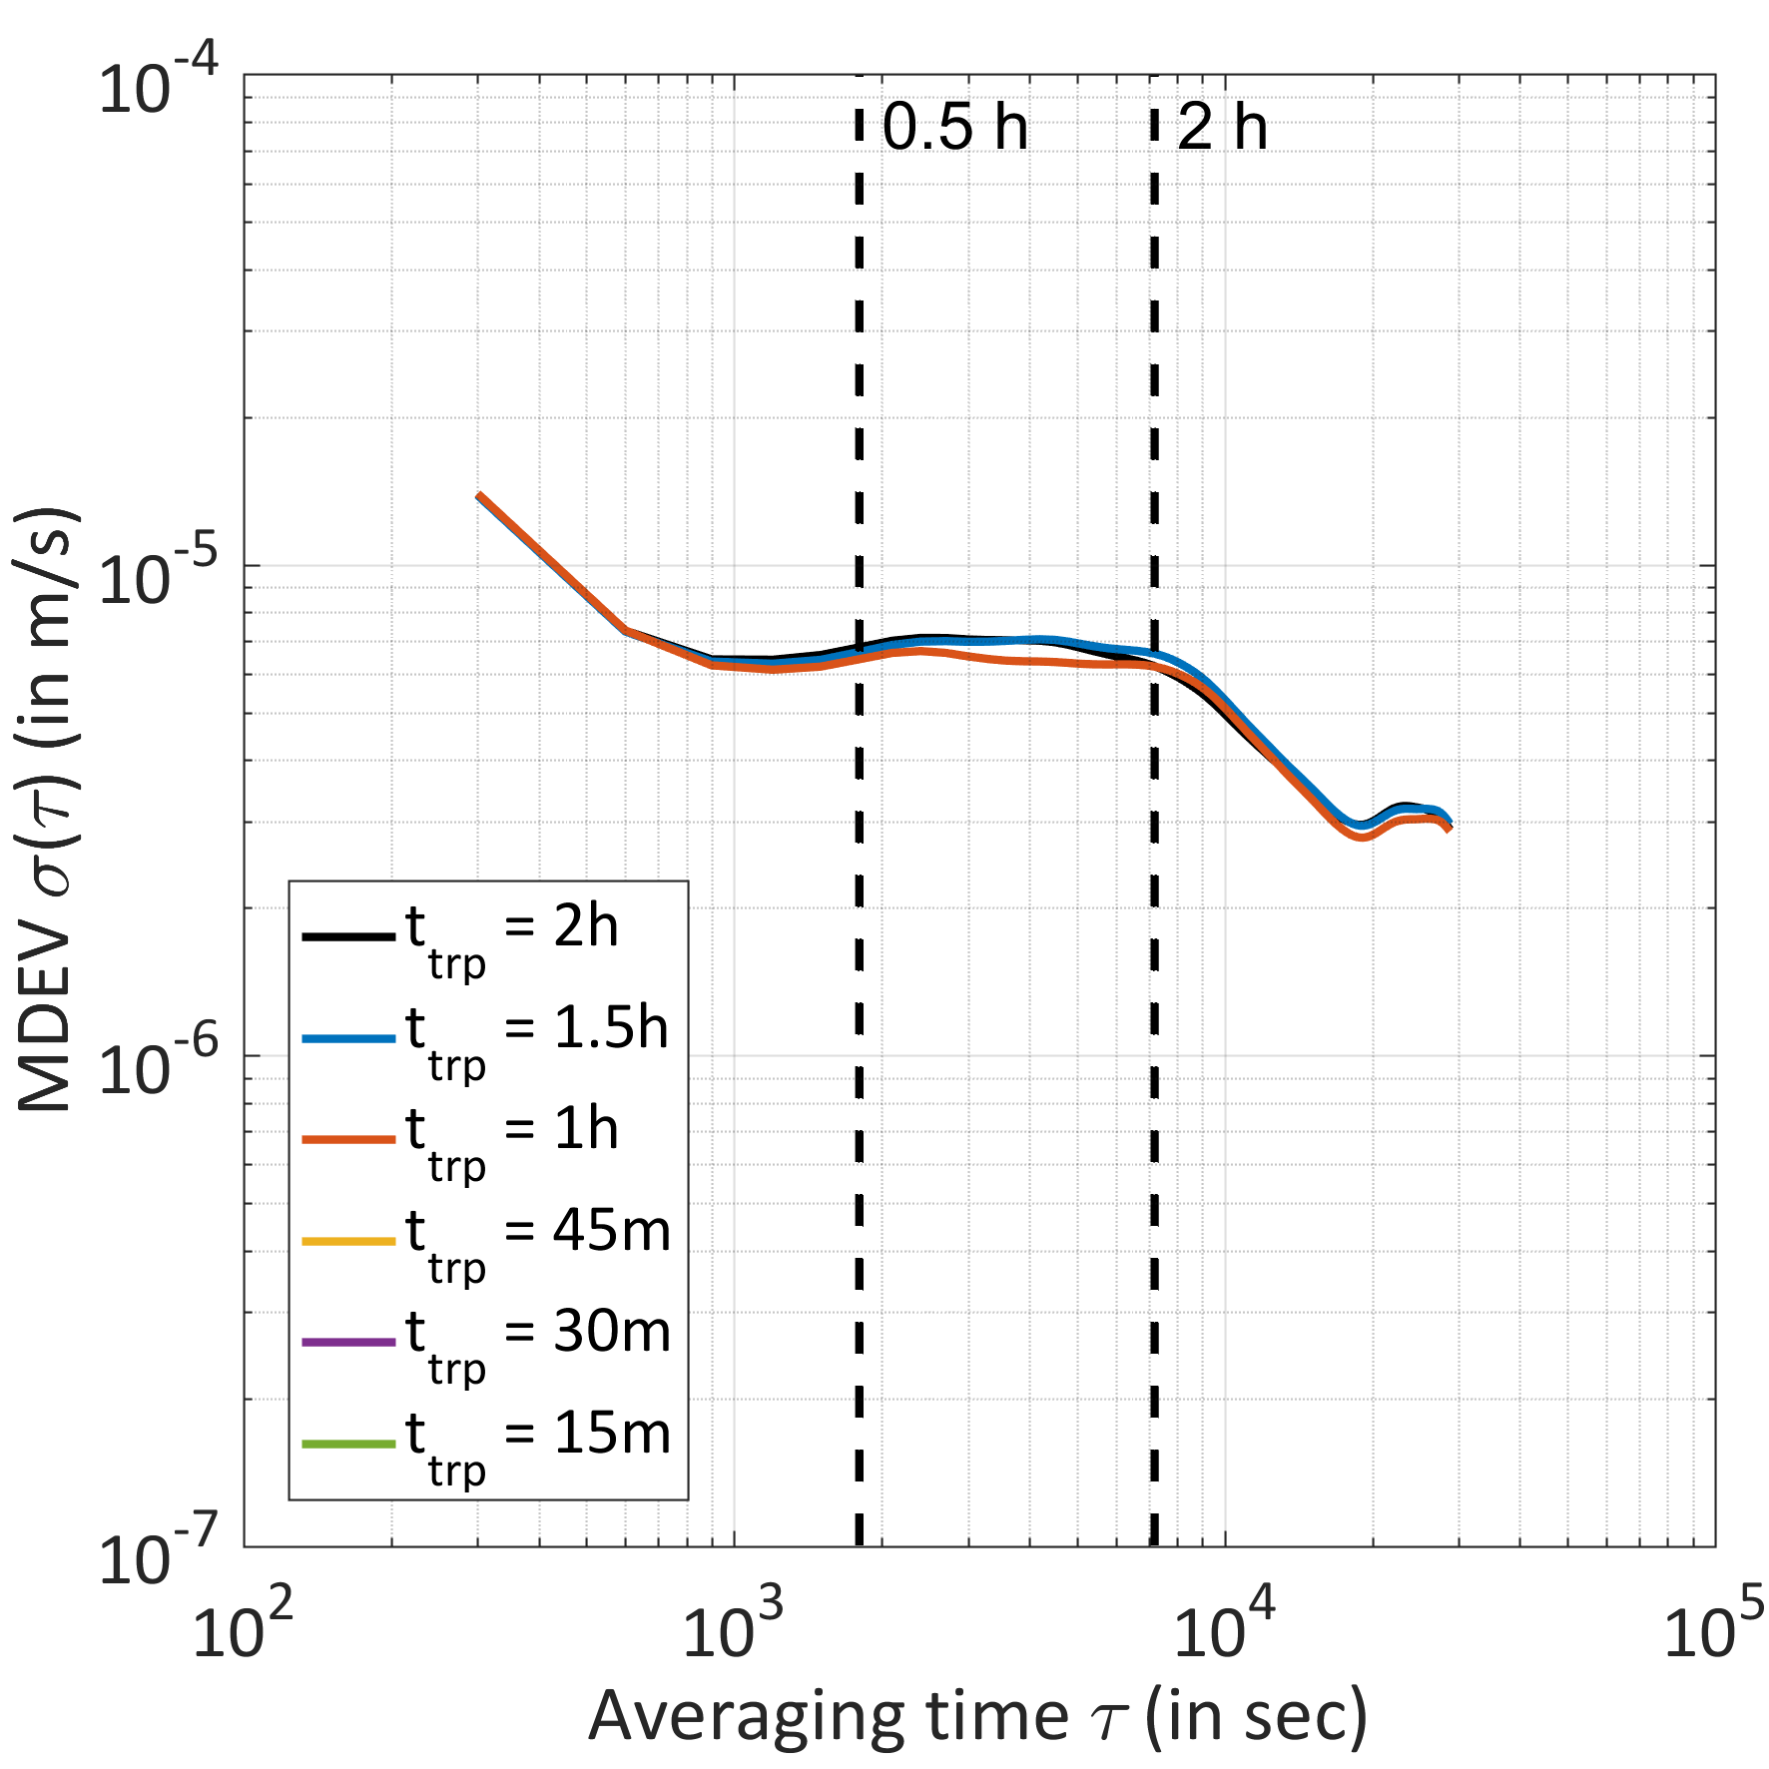
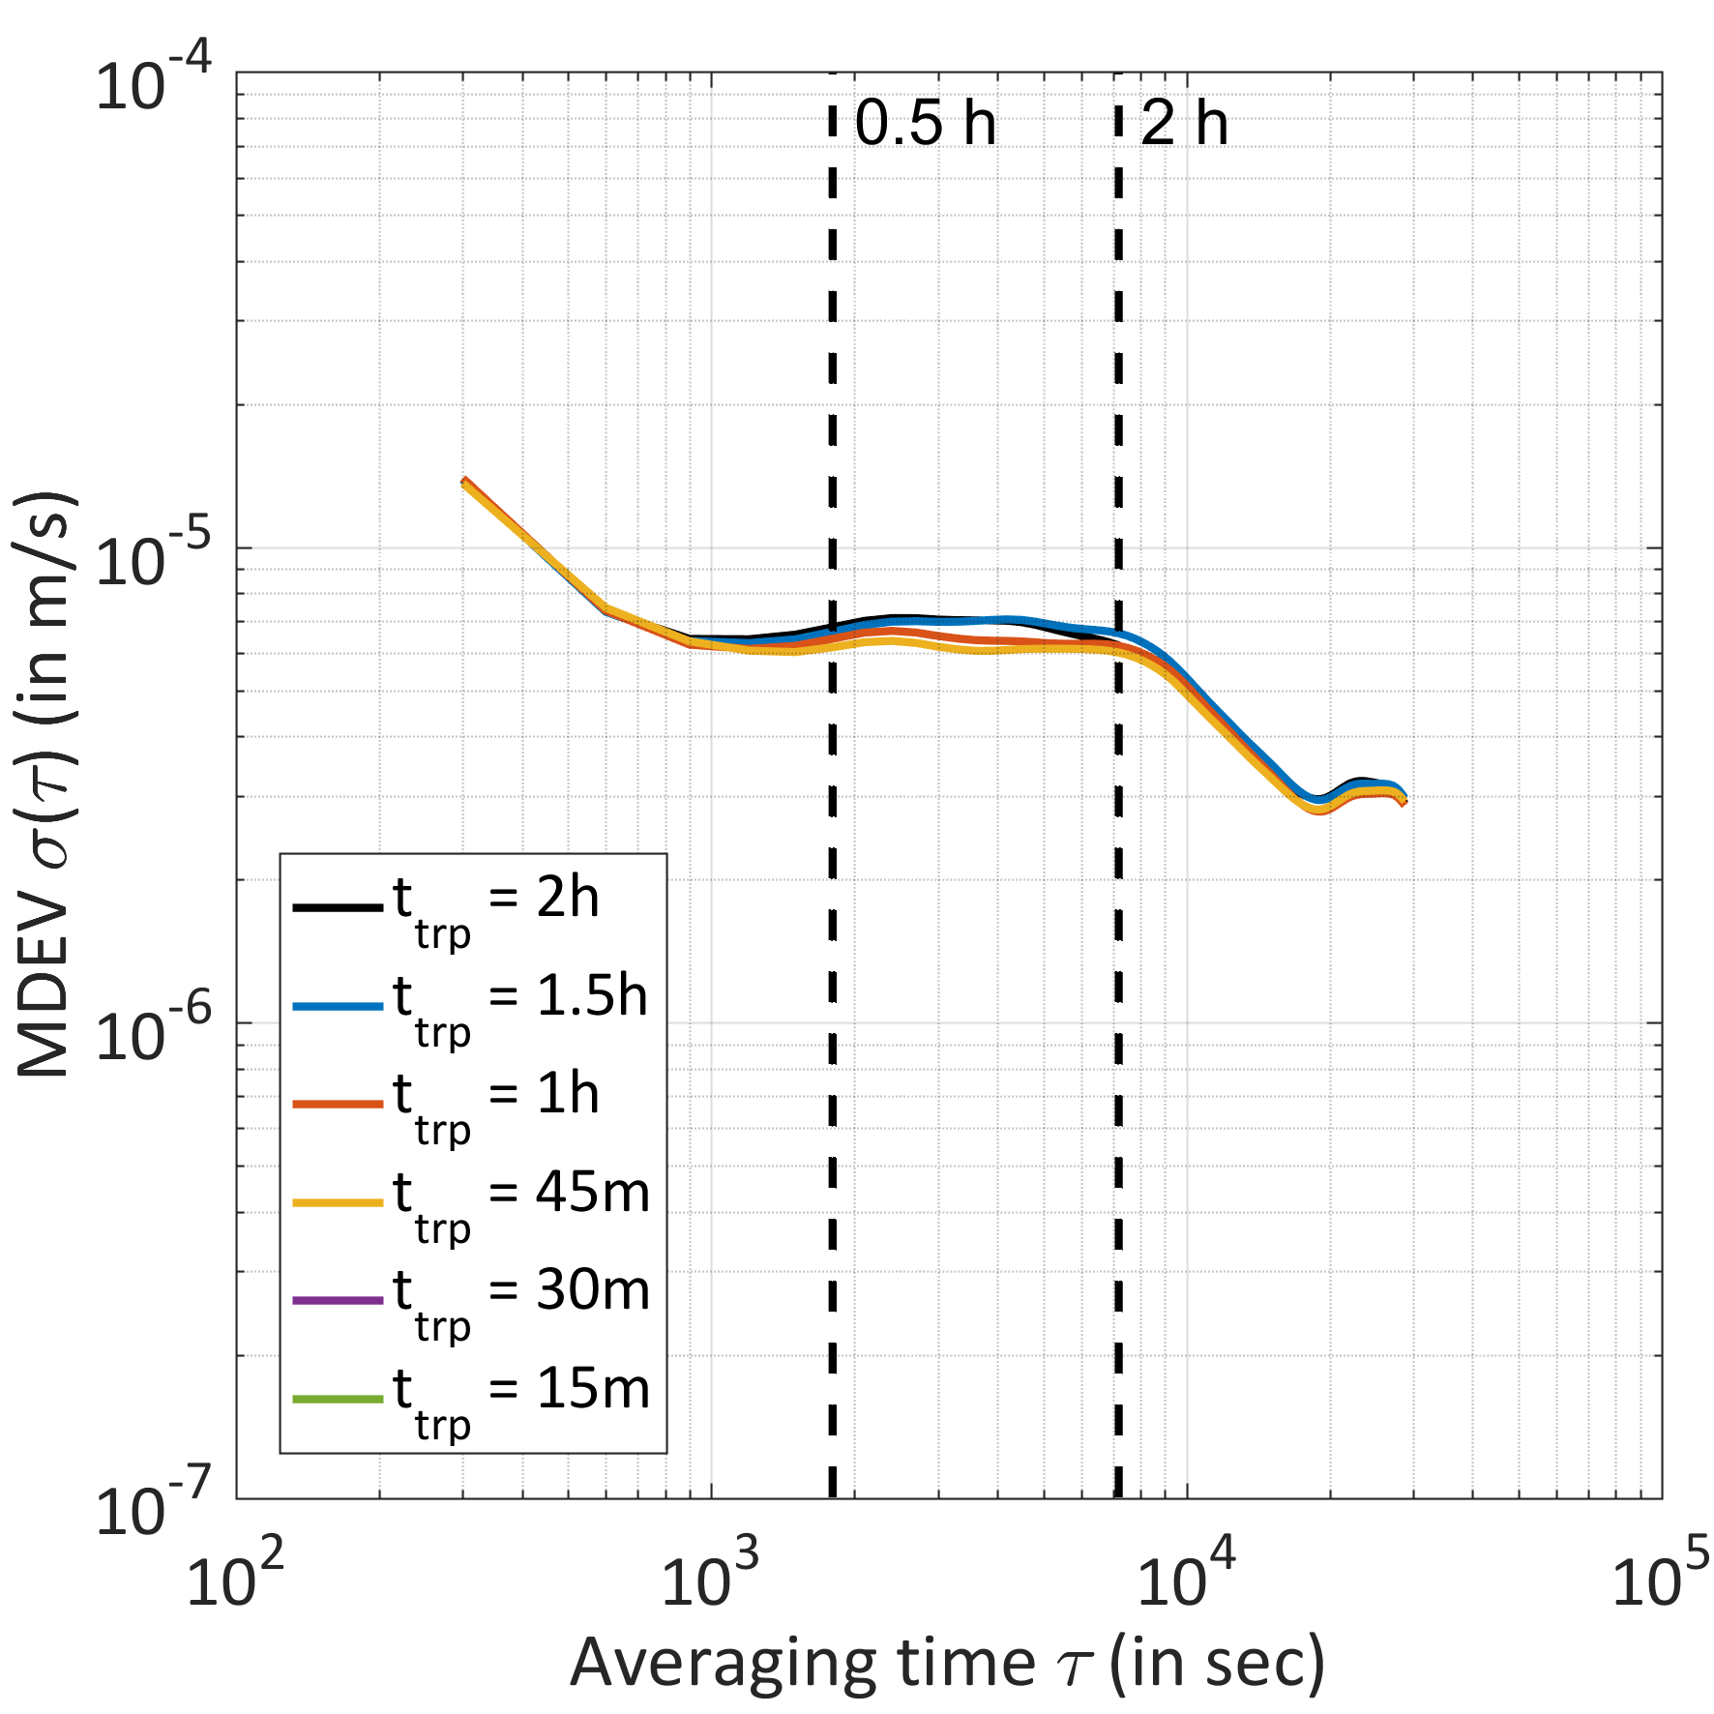
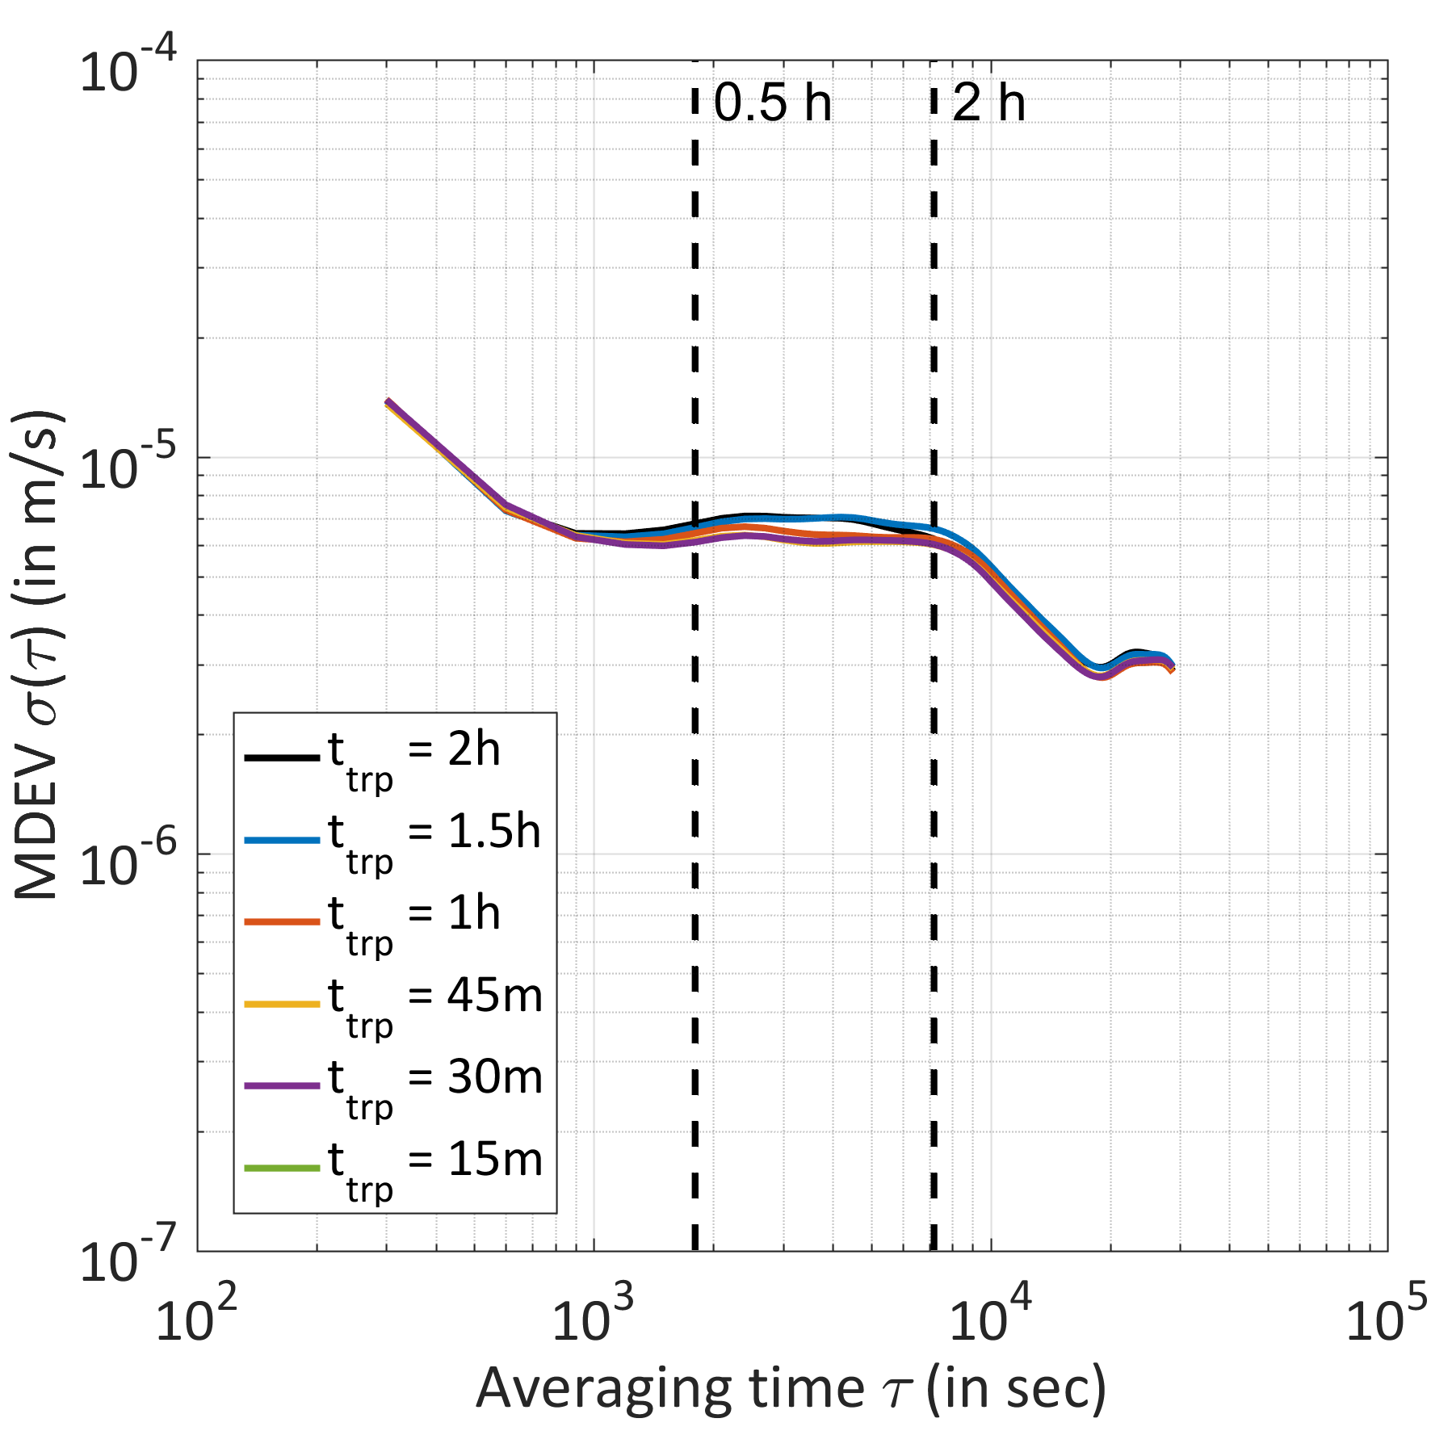
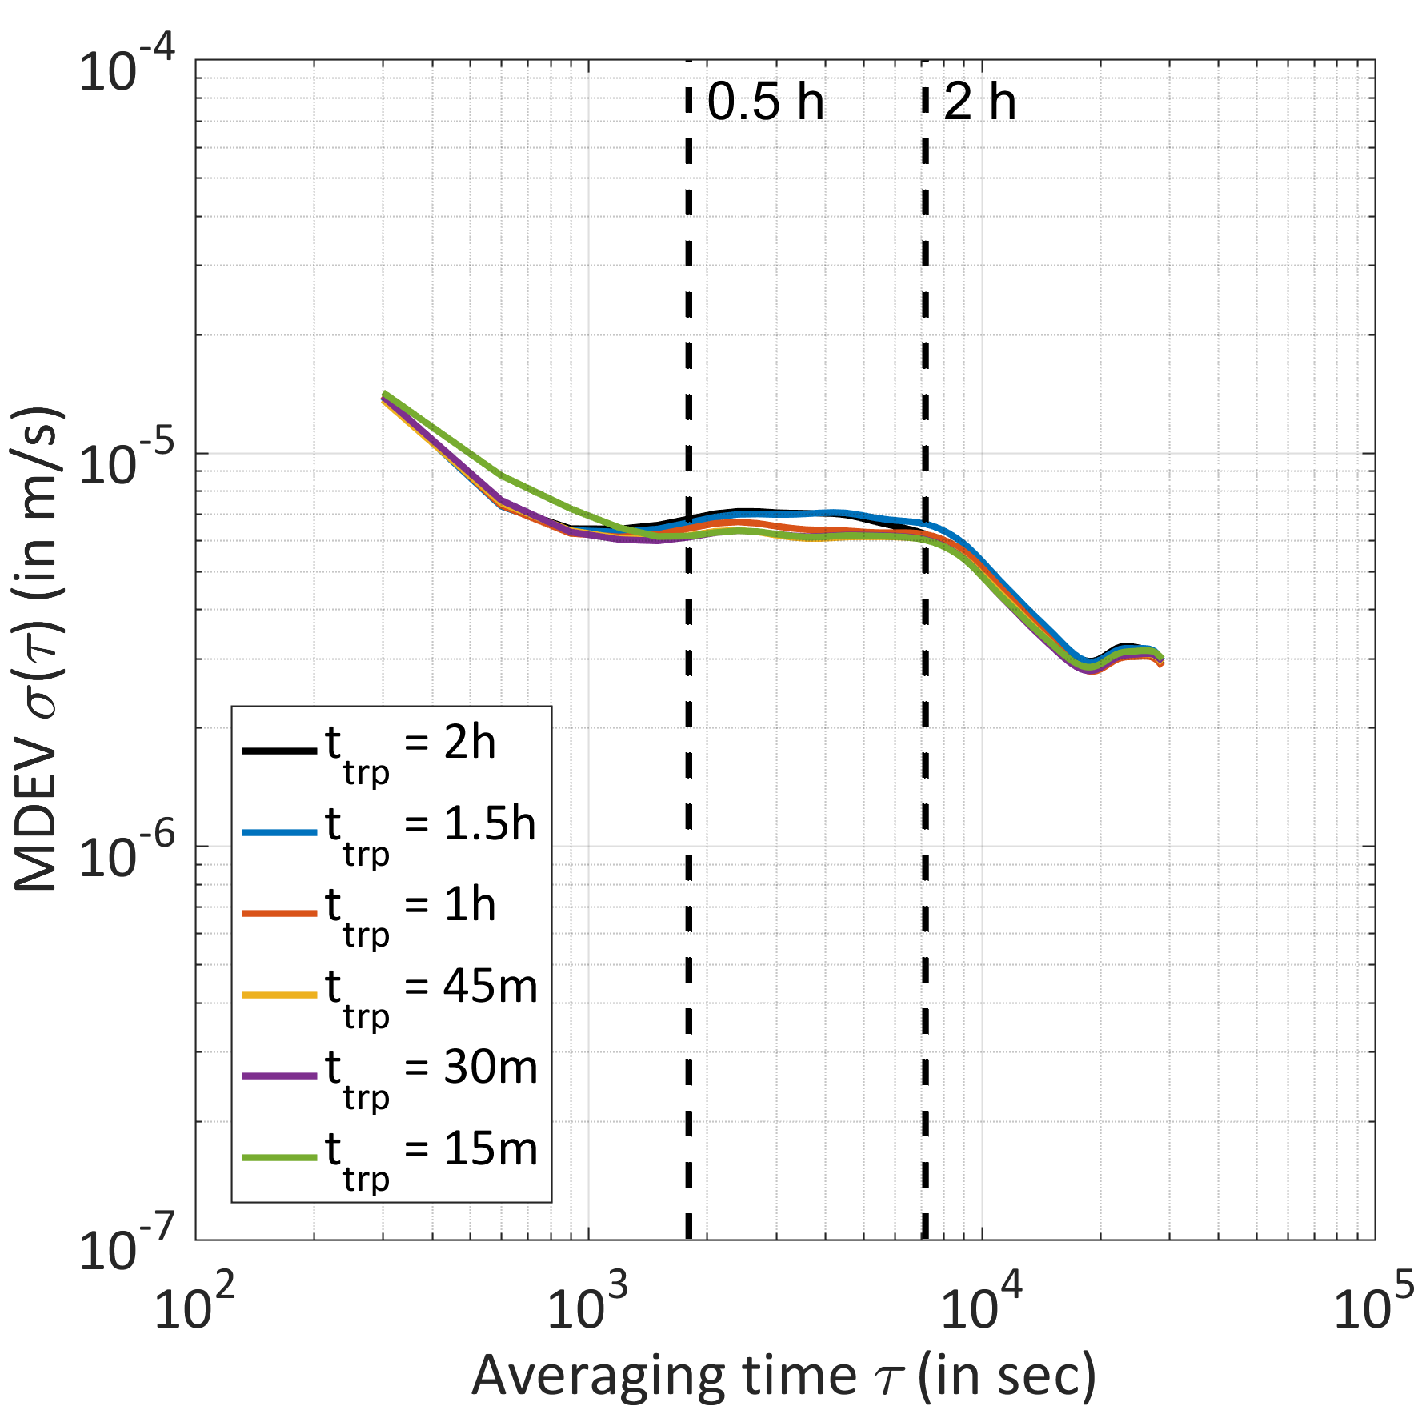
Kinematic station height: varying the ZPD resolution
CEBR
CEBR
No clock model
Clock model with 1 mm constraint

Slide 9
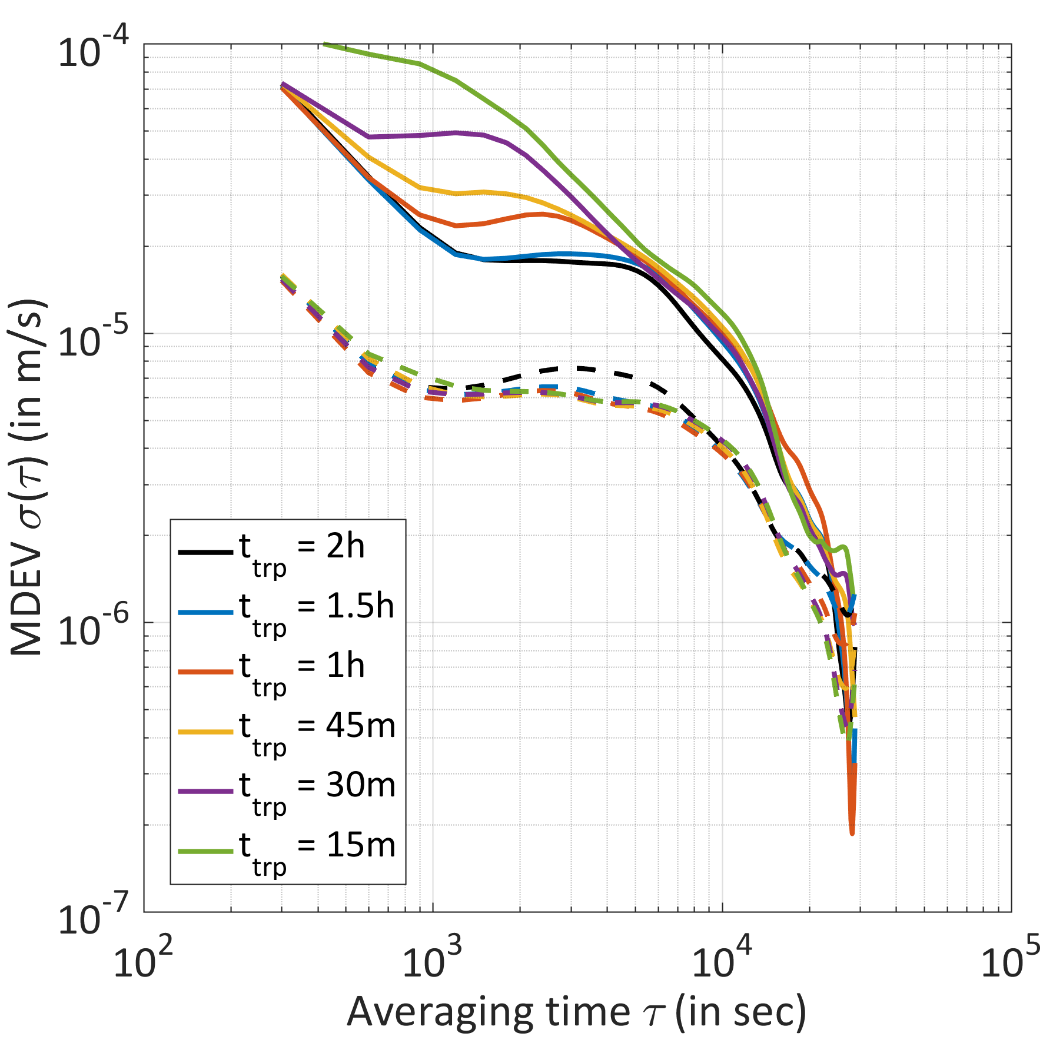
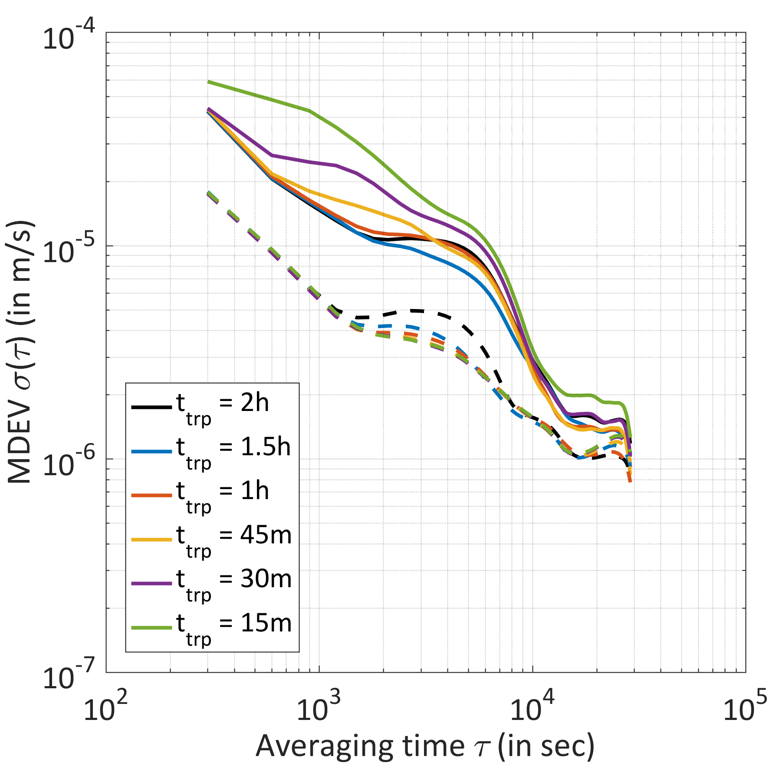
Kinematic station height: varying the ZPD resolution
PTBB
PTBB
Aug 2015 without (solid) and with (dashed) clock model Nov 2015

Slide 10
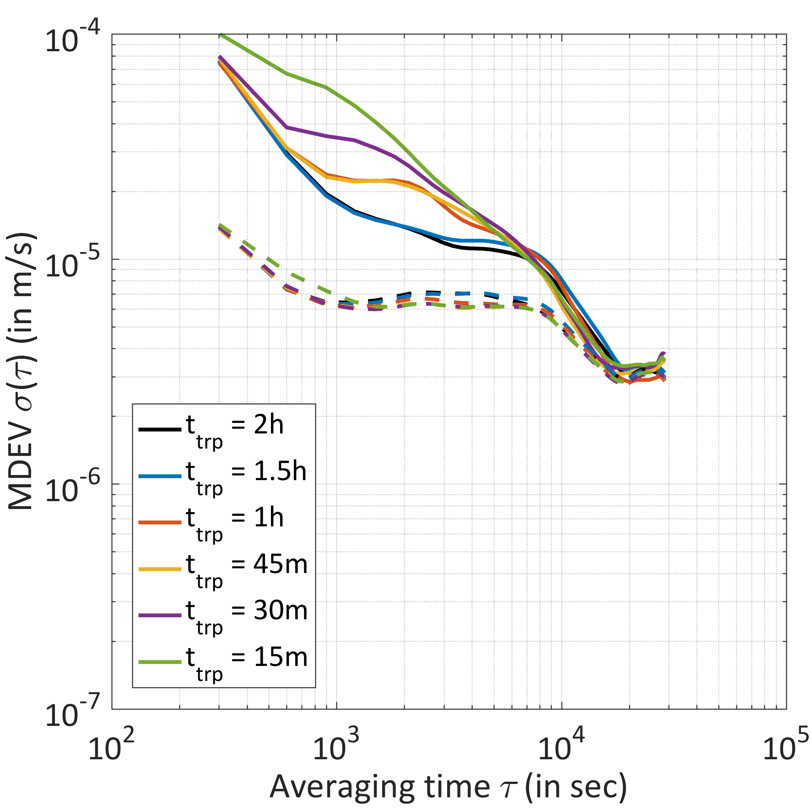
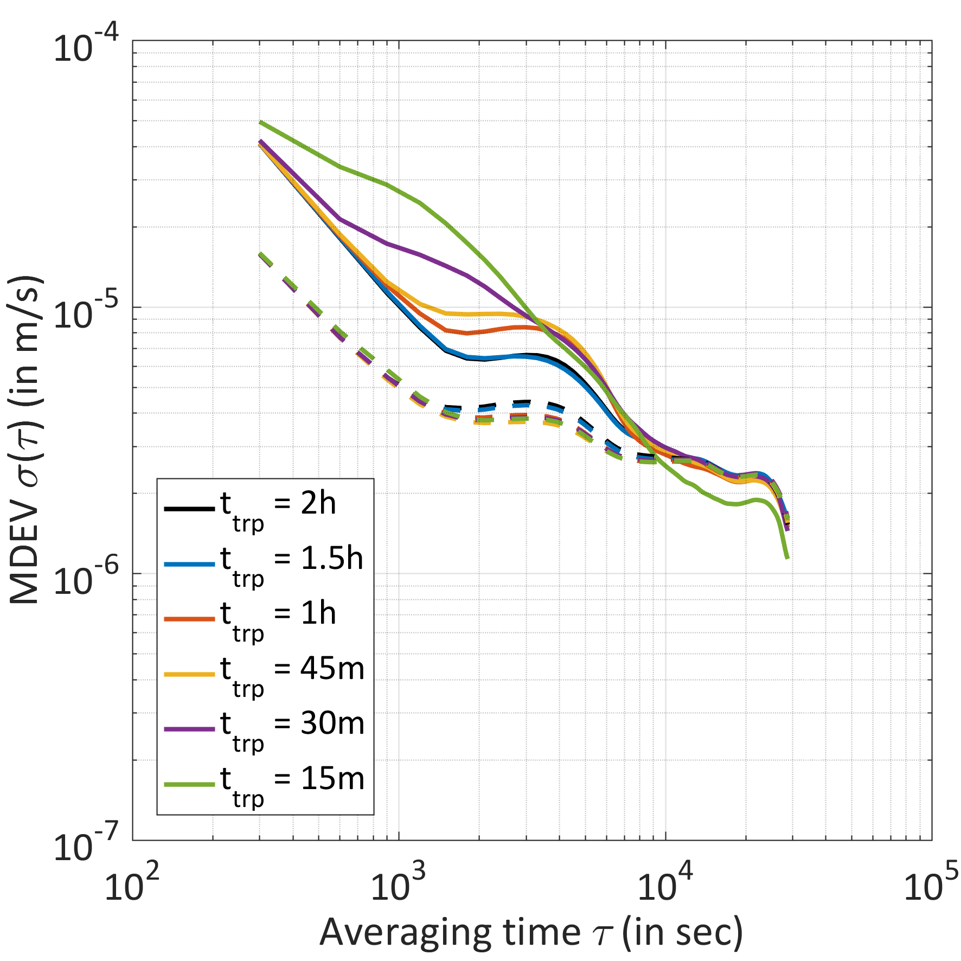
Kinematic station height: varying the ZPD resolution
CEBR
CEBR
Aug 2015 without (solid) and with (dashed) clock model Nov 2015

Slide 11
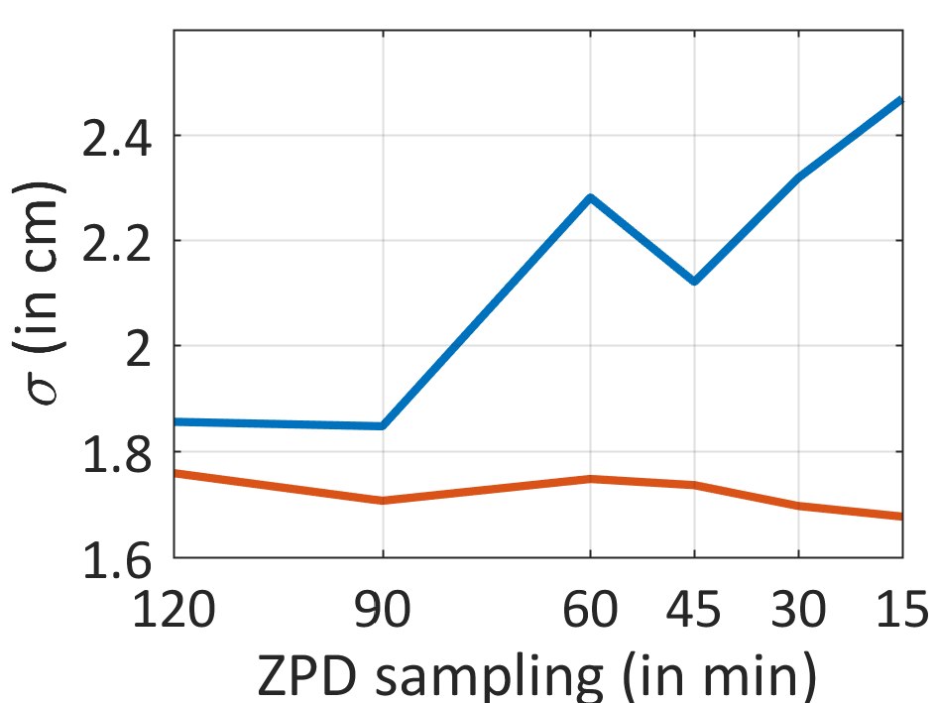
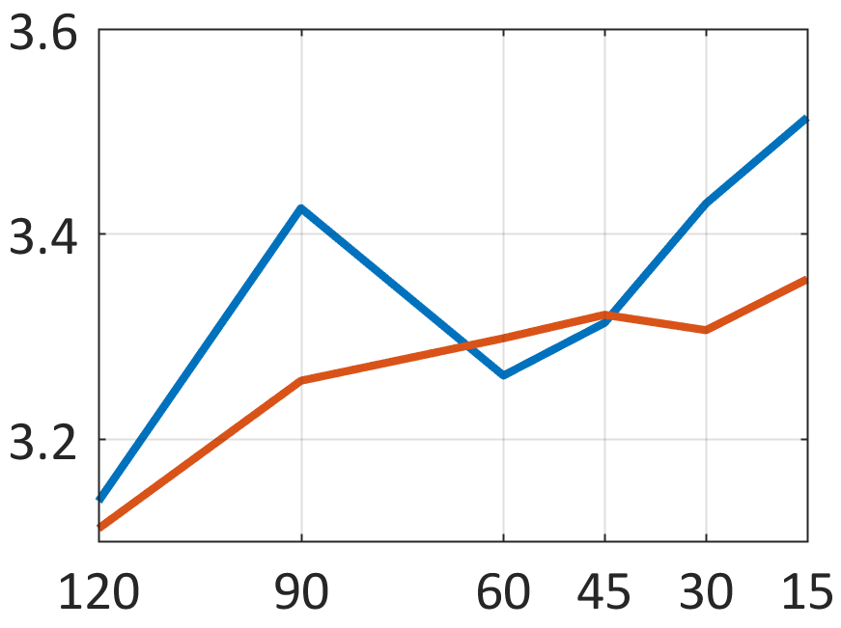
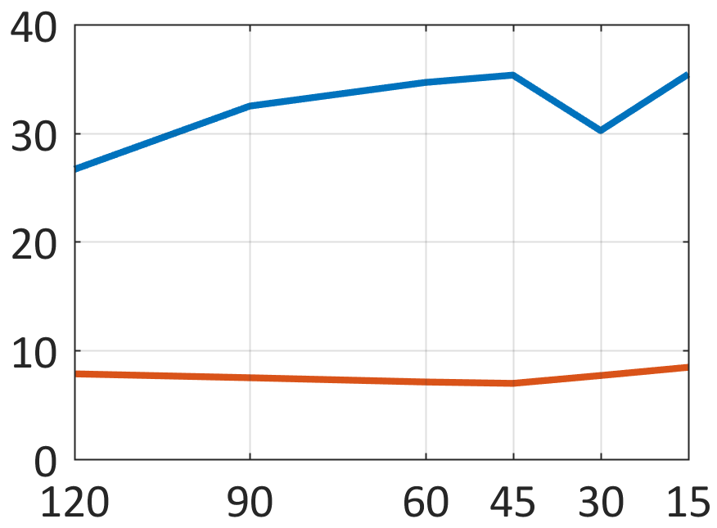
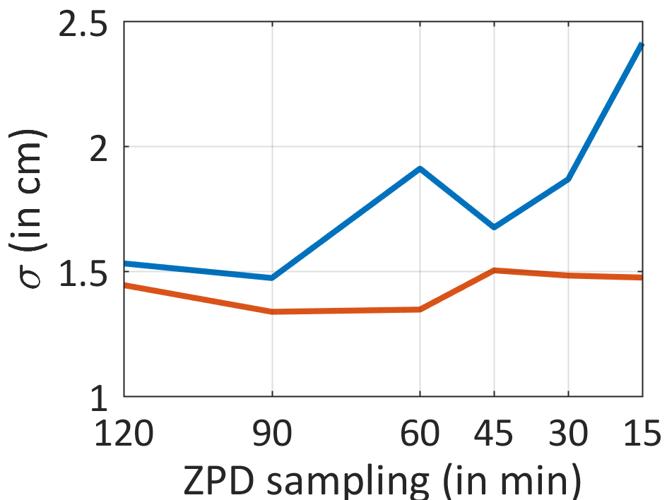
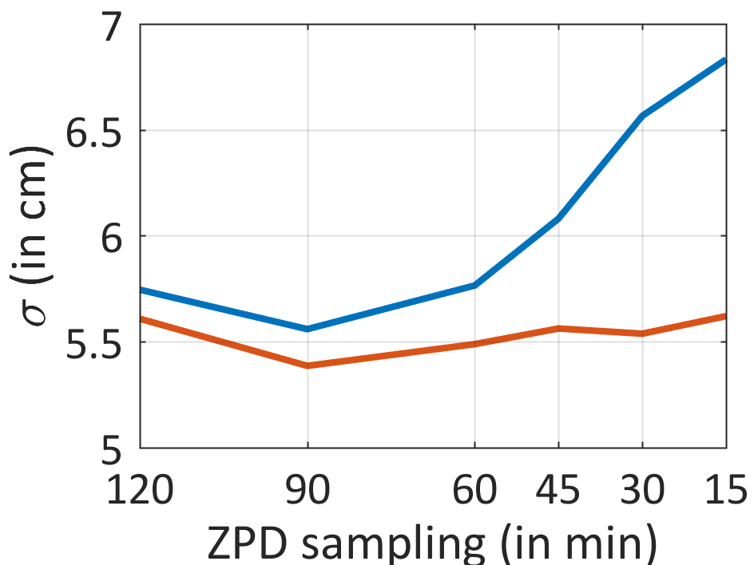
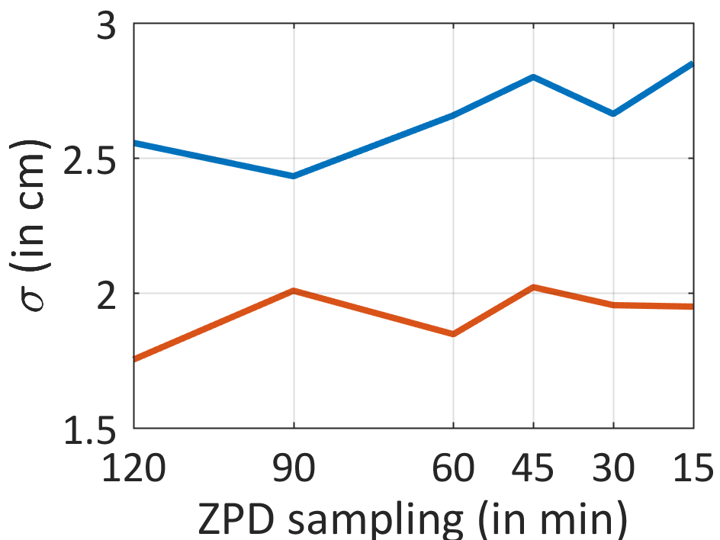
ZPD comparison with meteo data
CEBR
HERS
HRAO
STDs of the differen-ces ZPD(GPS) – ZPD (meteo)
ZPD(meteo) are free from correlations with the heights and the clocks
→ Significant improve-ment in the ZPD stability, especially for high sampling rates
MGUE
PTBB
ZECK
Without clock modeling
With clock modeling
August 9, 2015

Slide 12
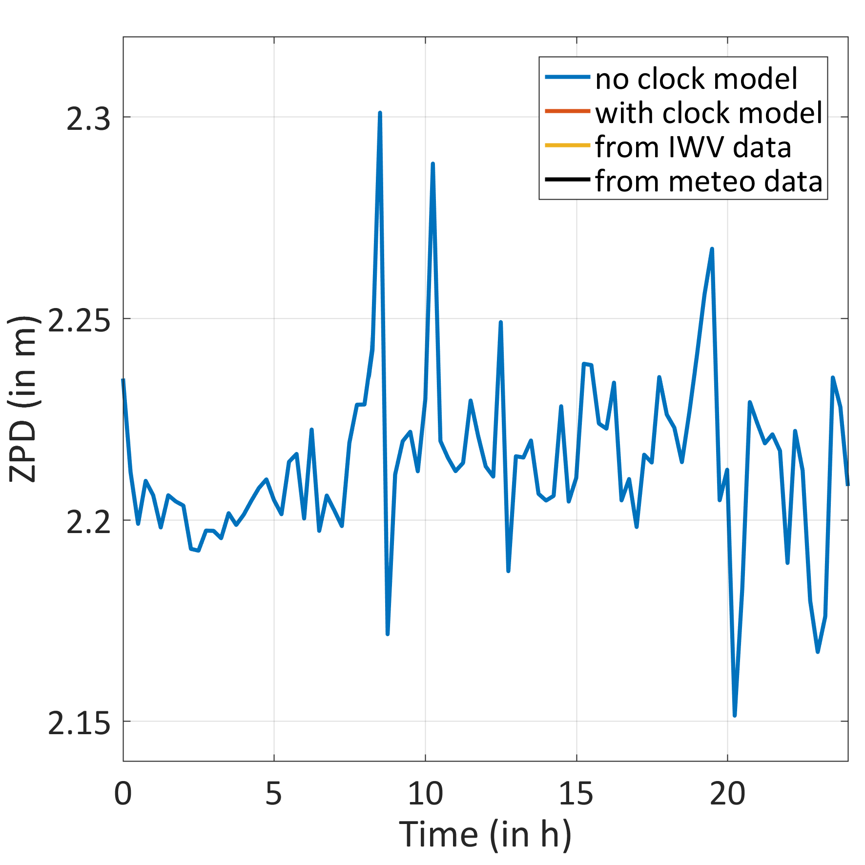
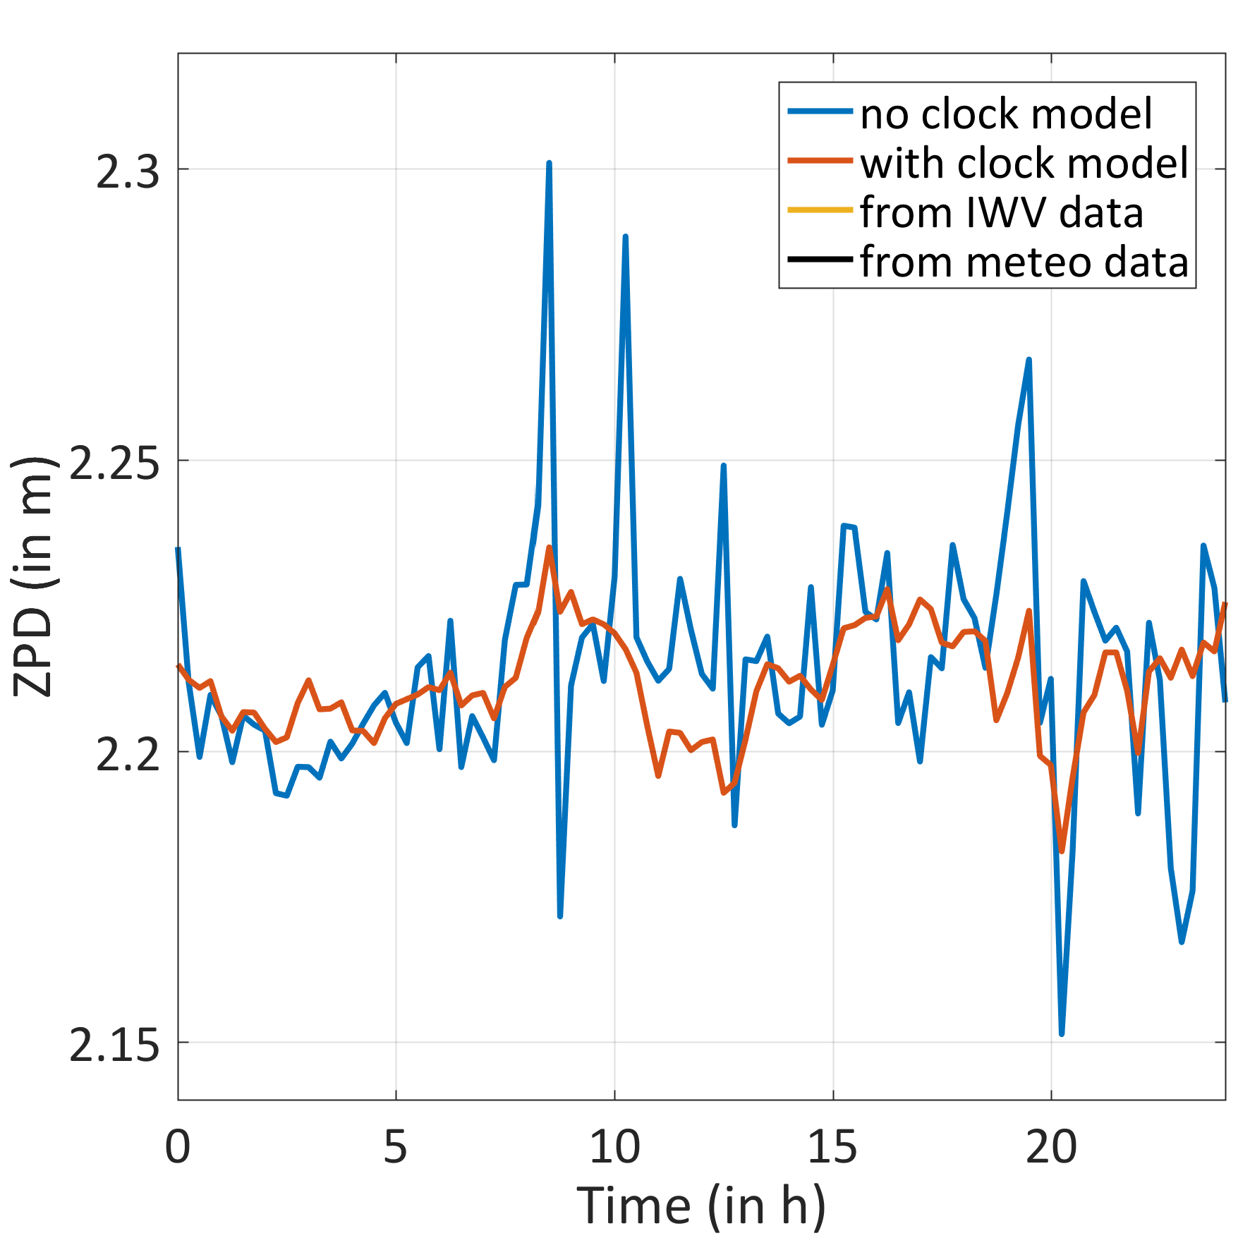
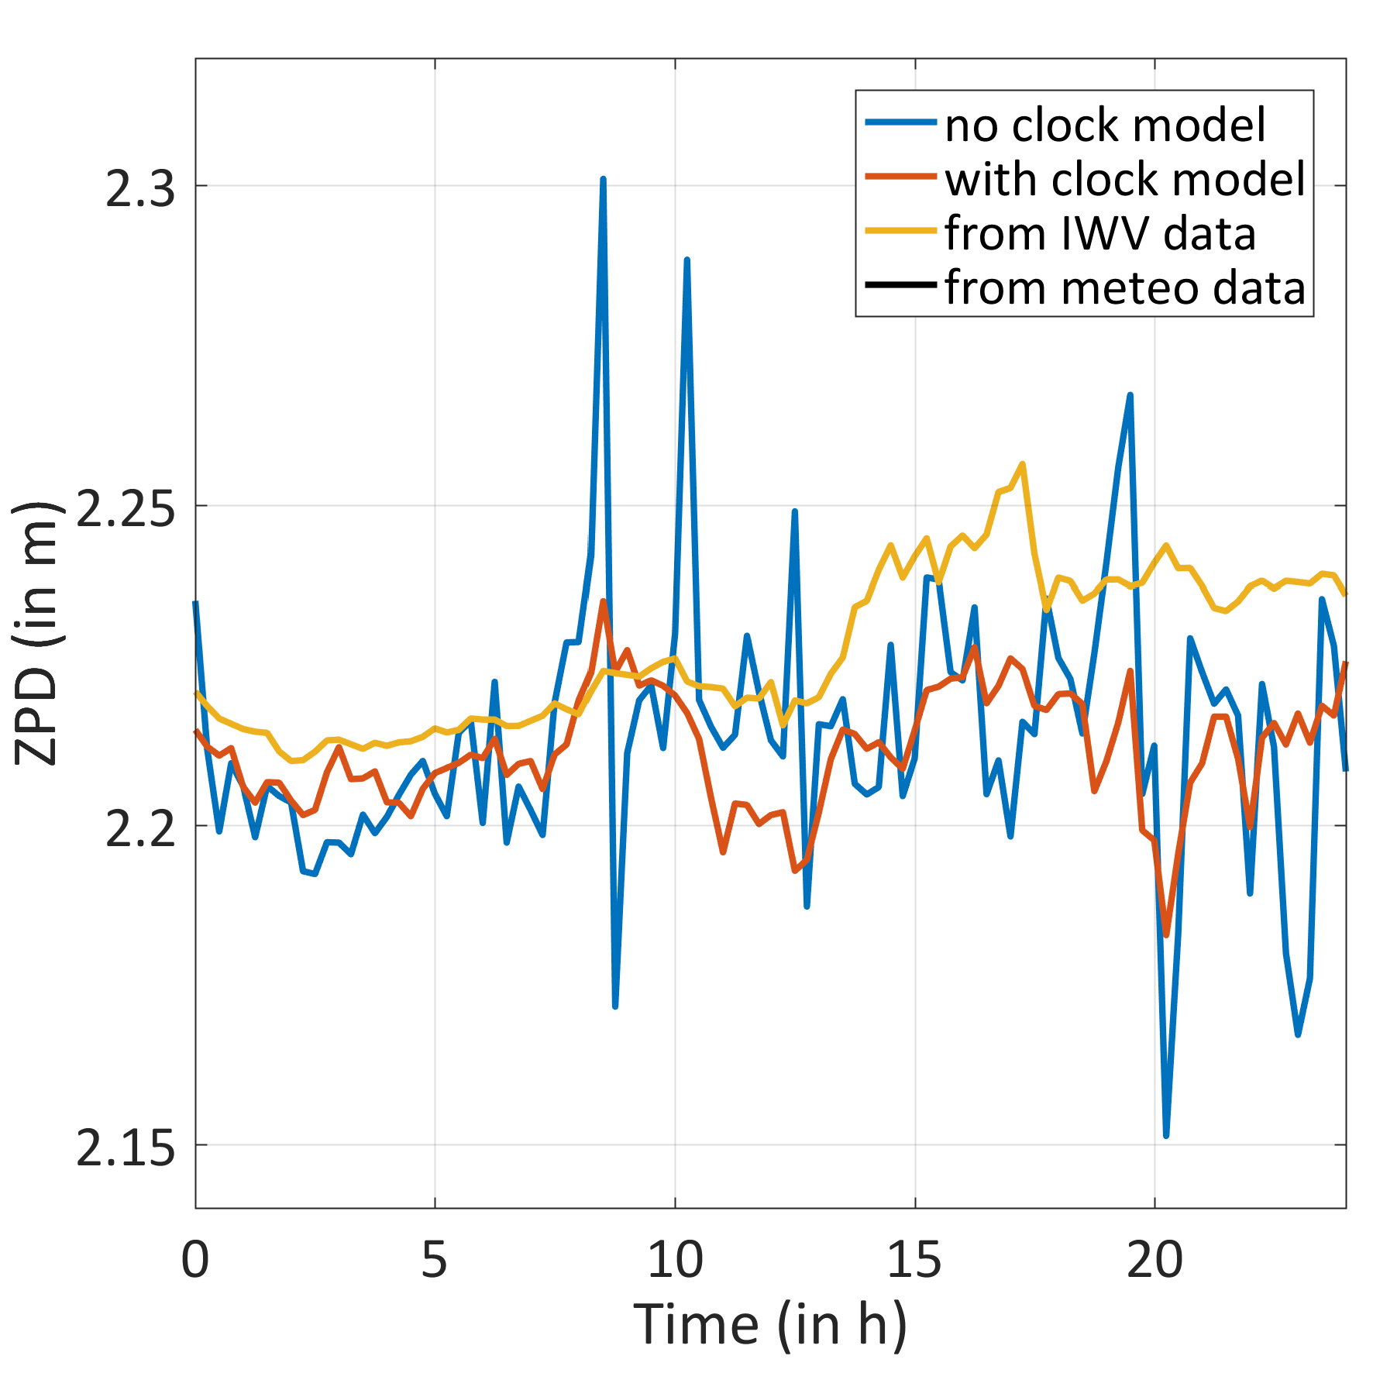
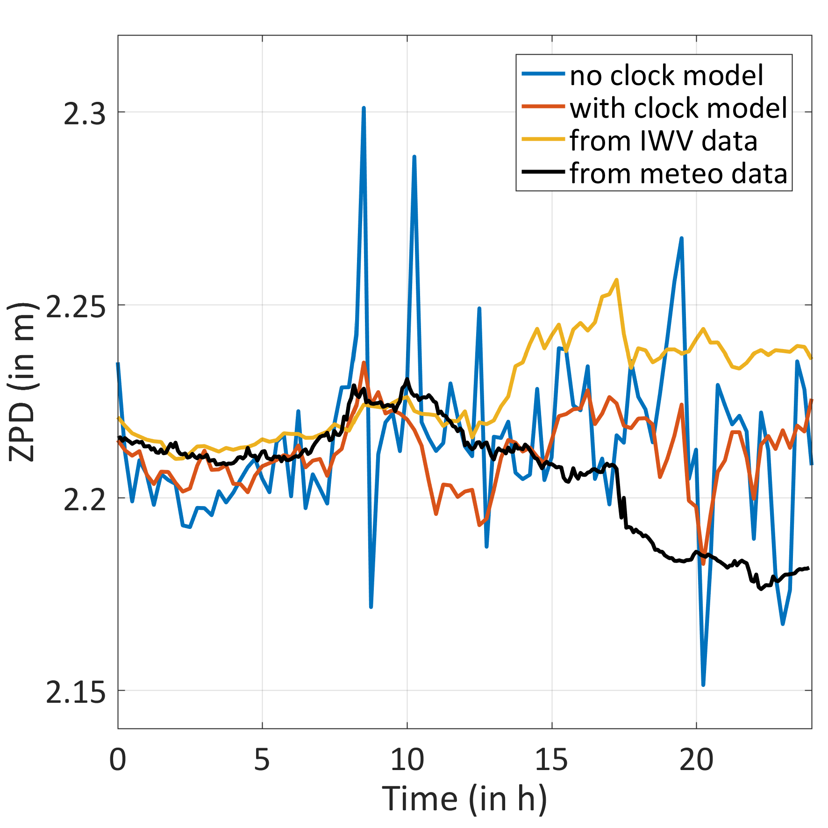
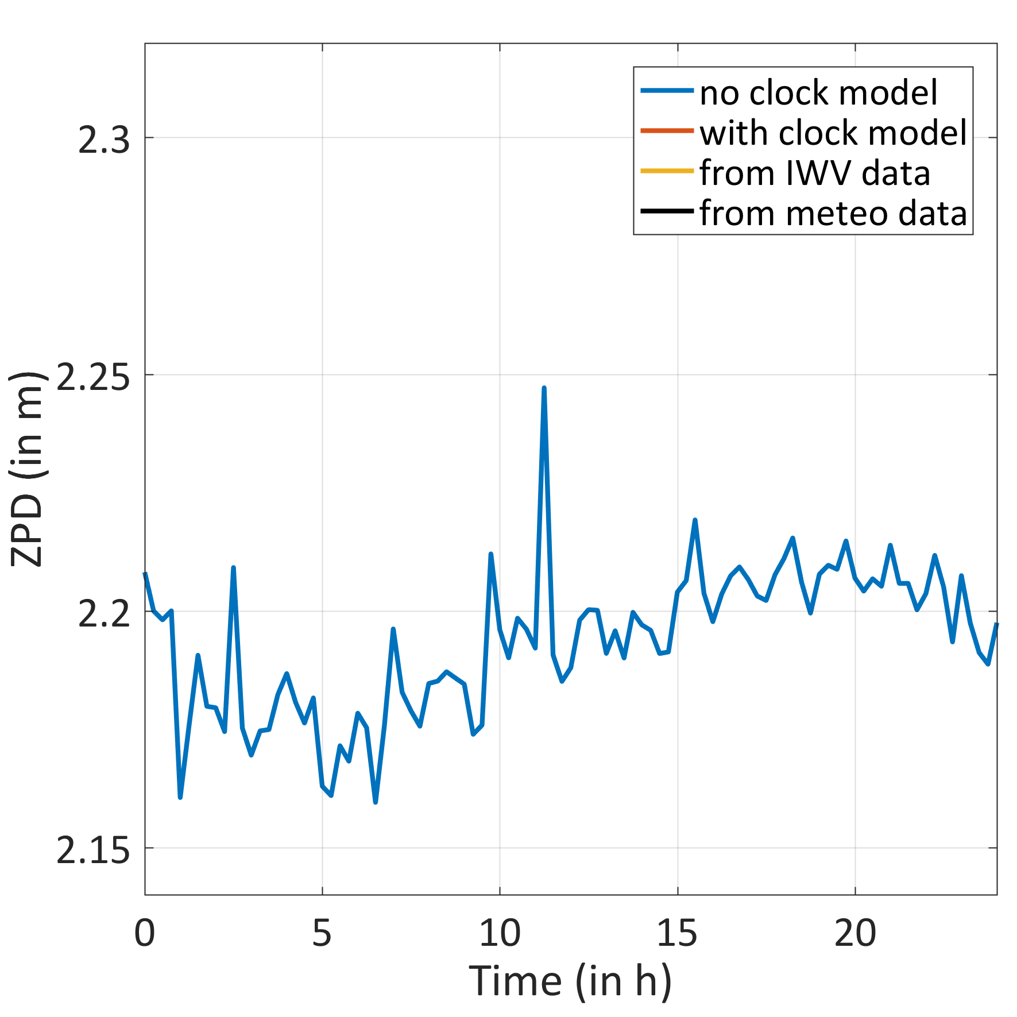
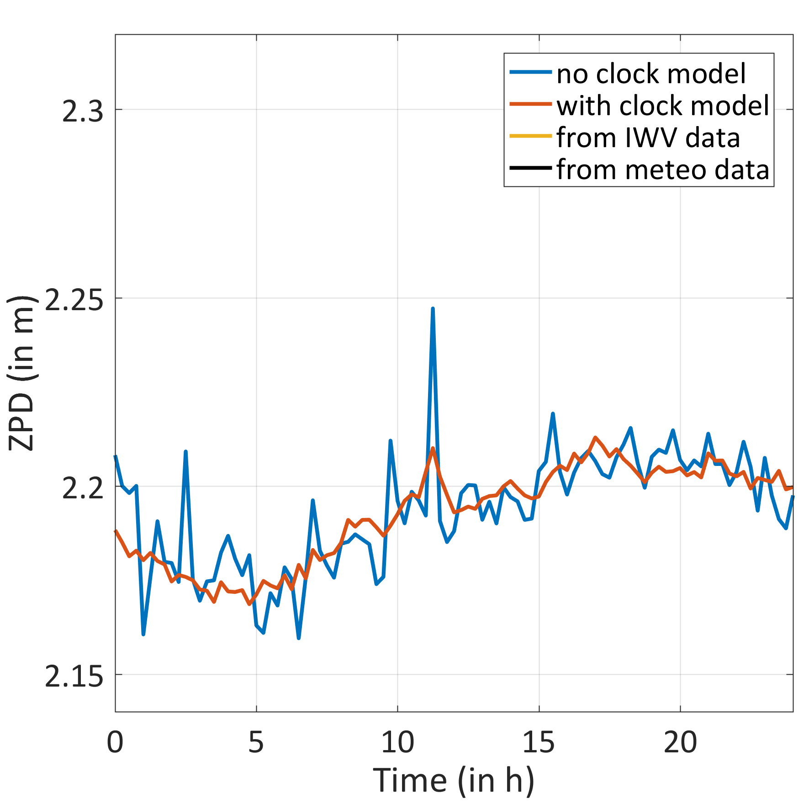
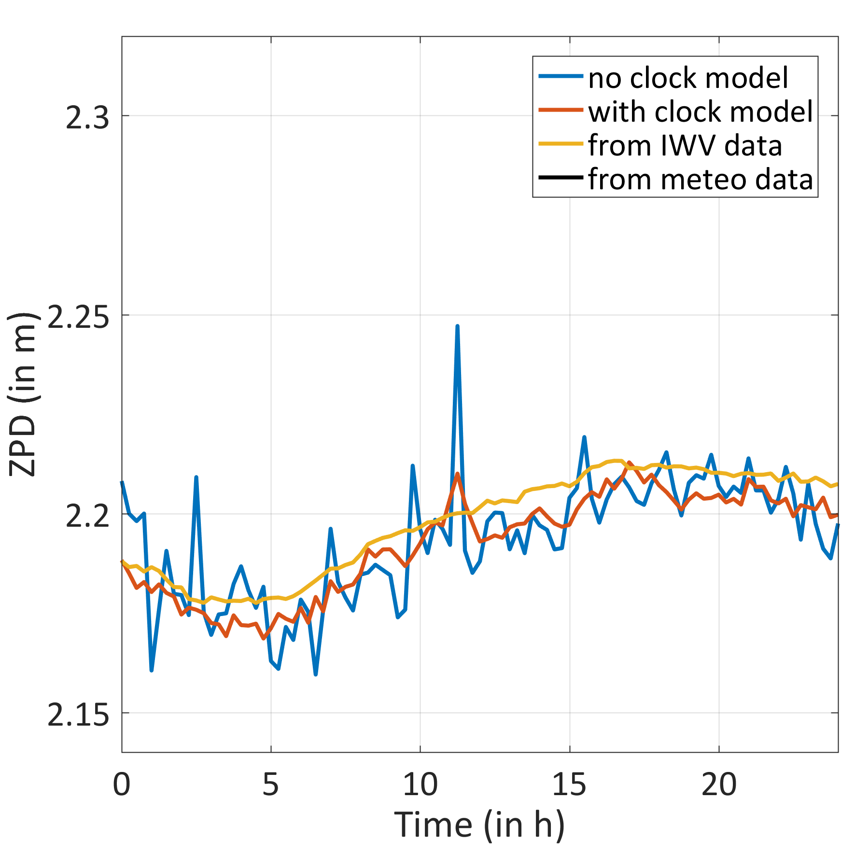
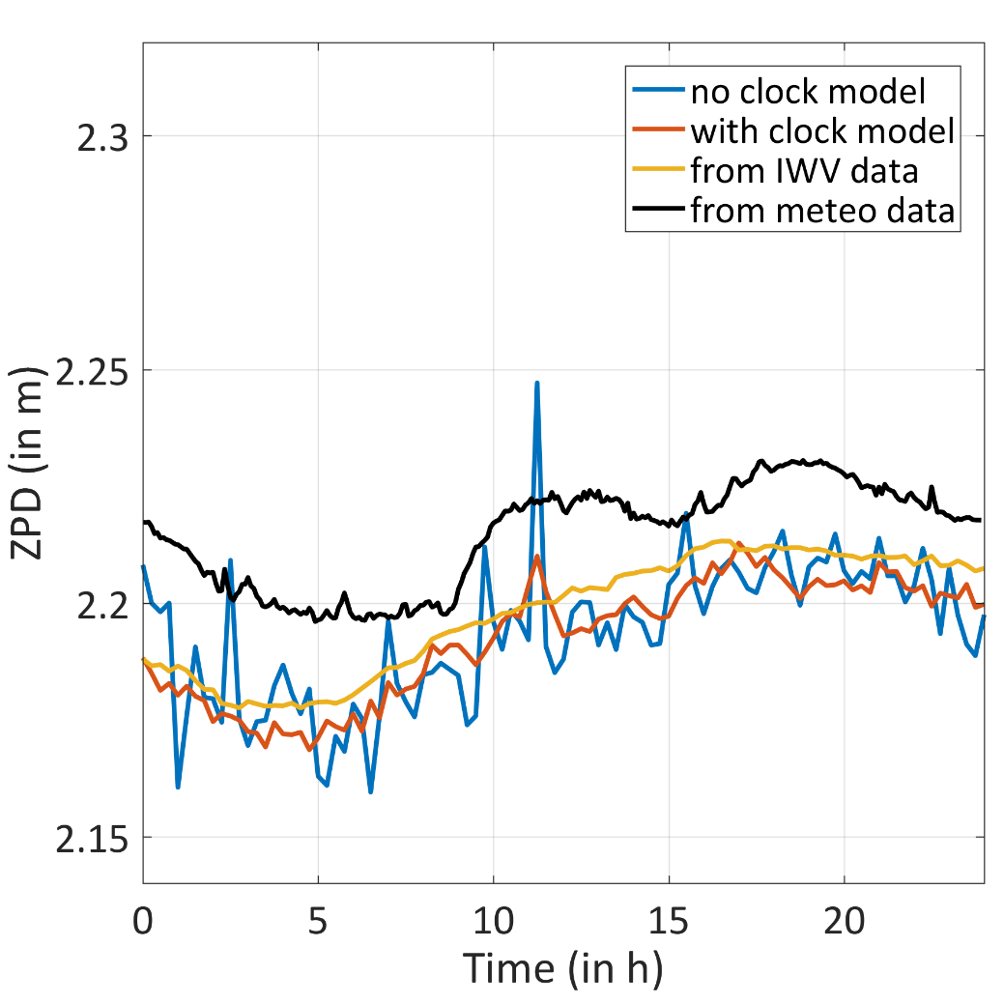
ZPD comparison with WVR, station CEBR
Comparison of ZPD from GPS and ZPD computed from IWV data (15 min samp.)
Aug 2015
Nov 2015

Slide 13
ZPD comparison with WVR, station CEBR, 2 days
Accuracy: comparison of ZPD from GPS with/without clock model
Reduction of the ZPD RMS when applying the clock modeling
Higher reduction at high sampling rate for the ZPD estimates
→ Significant improvement of ZPD with clock modeling
[mm]
15 min
2 hours

Slide 14
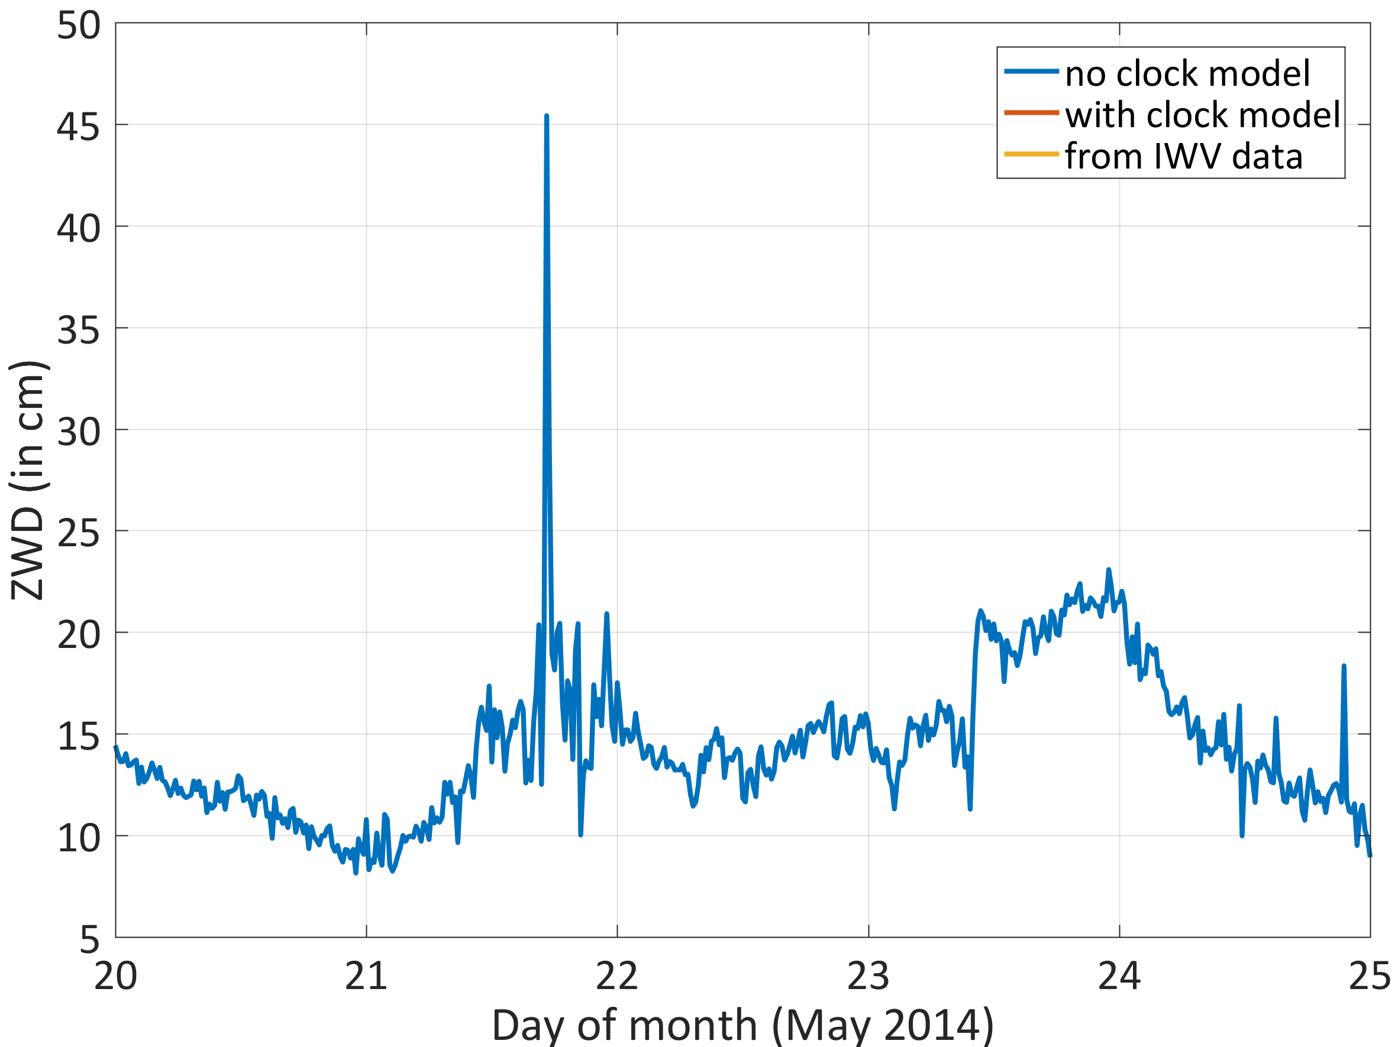
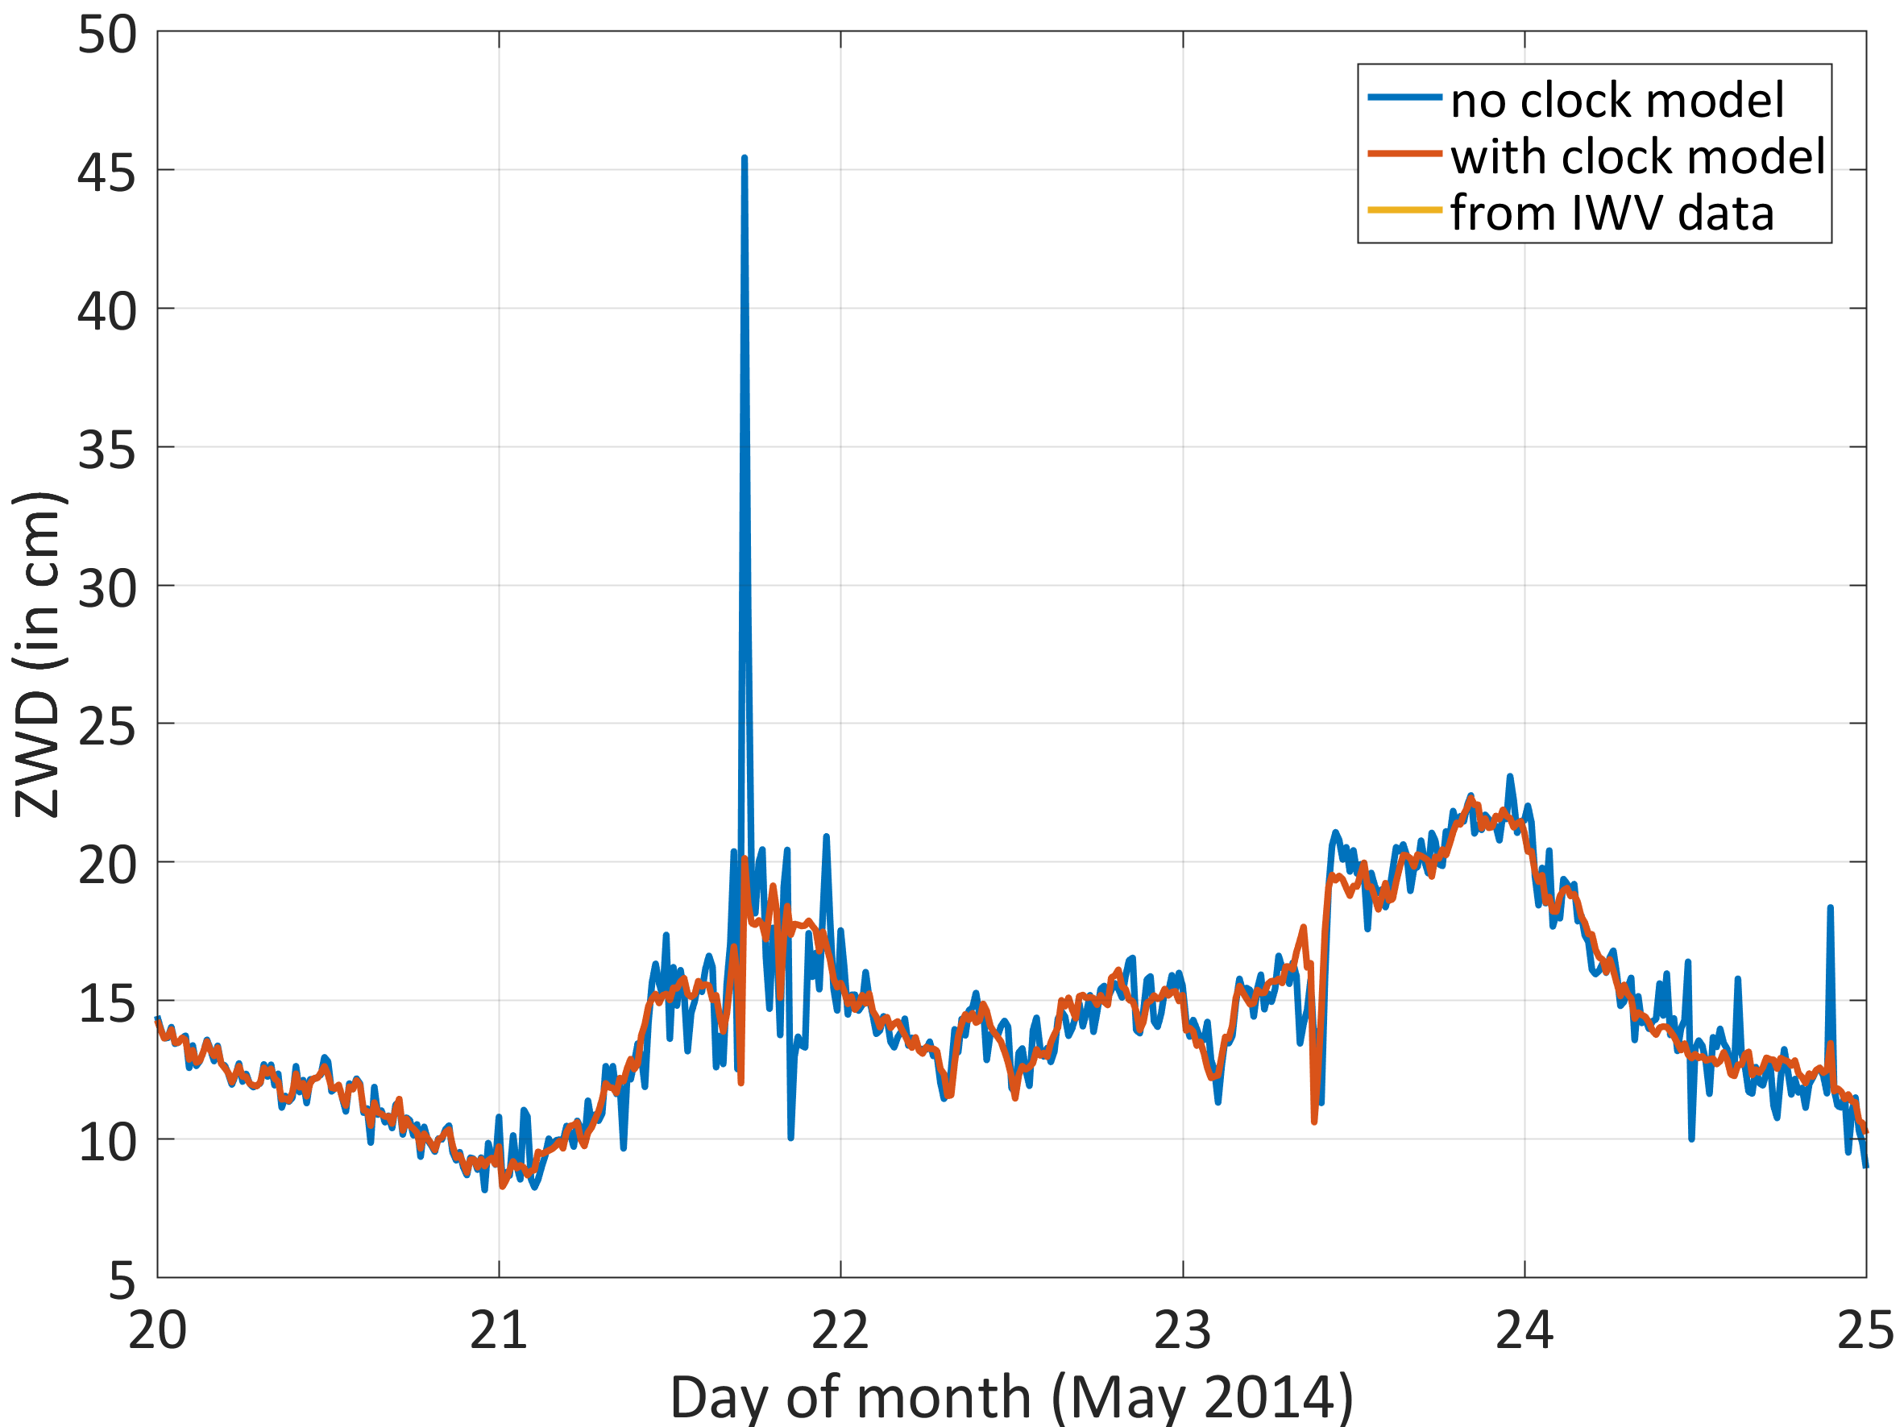
ZWD comparison with WVR, station ONSA, 5 days
Comparison of ZWD (zenith wet delay) from GPS with/without clock model and ZWD from WVR data (15 min sampling of ZWD, May 20-24, 2014)
→ Much increased stability
May 2014

Slide 15
ZWD comparison with WVR, station ONSA, 5 days
RMS of difference between ZWD from WVR data and from GPS
→ All solutions imptrove with clock modeling

Slide 16
Conclusions
Clock modeling not only improves kinematic heights but also ZPDs
With clock modeling there is no degradation in ZPDs, even for time resolution for ZPDs of 15 minutes
Comparison with meteo and WVR data (CEBR and ONSA) → improved ZWD for all solutions, when modeling the station clock
Next step: verification with a much larger data sets

